Slide 1
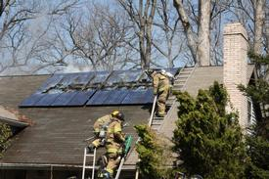
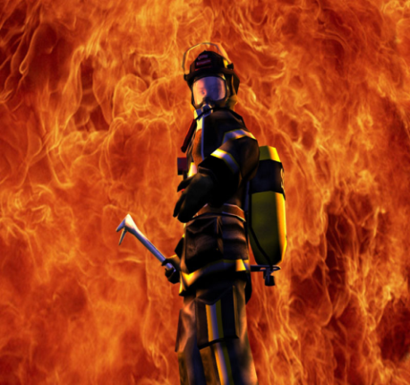
Overview of SOLAR PV Systems & Firefighter Safety

Slide 2
RAI Participants
Chris Tranchina – Project Manager
Joe Camarota – Chief Engineer

Slide 3
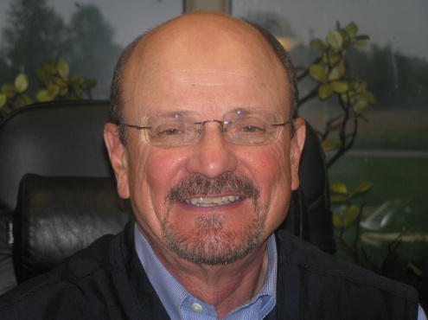
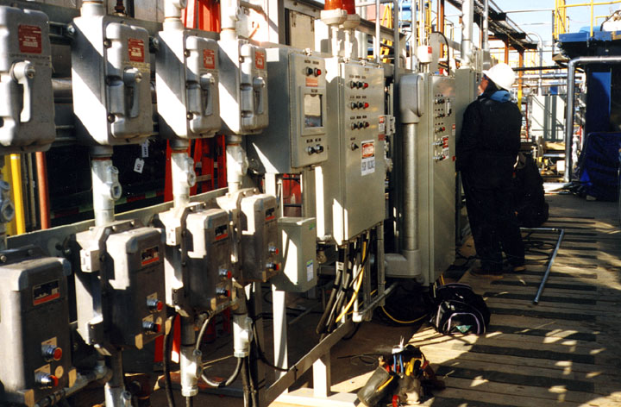
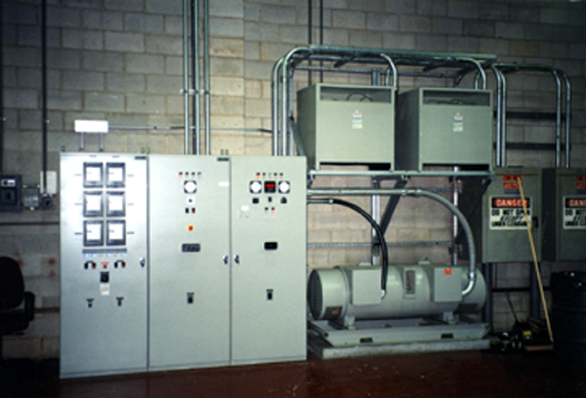
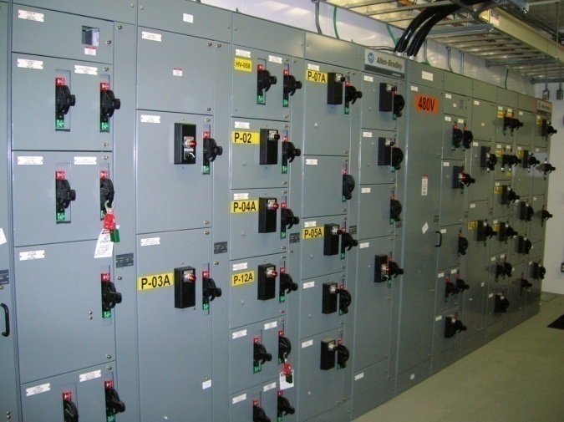
RAI History
Ray Angelini started RAI 37 years ago as a commercial electrical contractor

Slide 4
RAI Today
SOLAR ENERGY
Commercial Electrical
Power Systems Testing and Commissioning
.
Industrial Electrical
Data Communications
Transit/Signaling /Heavy Rail
General Construction

Slide 5
RAI Today
Multi-divisional design/build/maintain company, focused on the Philadelphia area and South Jersey
Solar Energy Division is one of the largest on the East Coast – the absolute best quality record
425⁺ employees
Offices in NJ, DE and PA
Licensed in NY, NJ, PA, DE, MD and DC
Bonded for $150 Million

Slide 6
Just a Few of RAI’s Customers
Notes:
6

Slide 7
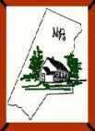
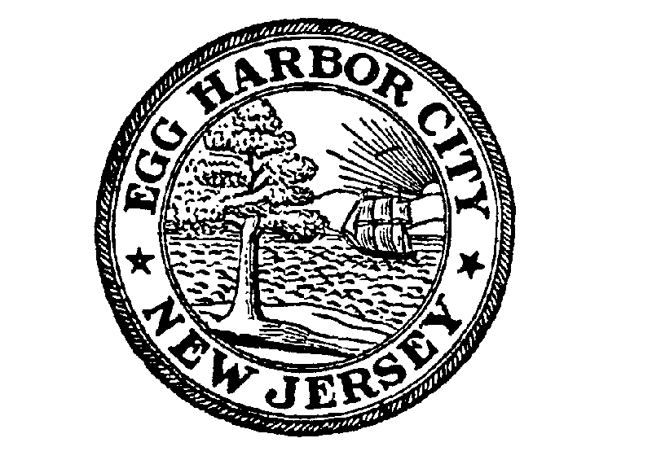
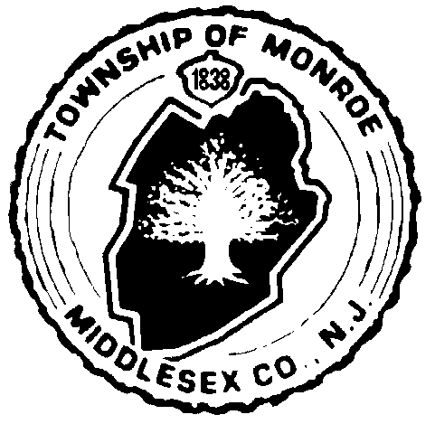
Some of RAI’s School Customers
Rahway Schools

Slide 8
Basics of Solar PV
Solar PV systems generate electricity from the sun.
Most systems are connected to the electric grid, providing power to the site. (Some systems equipped with batteries)
The systems are integrated with the electrical service through a service tap or directly through a reverse feed circuit breaker in the power panel.
AC current exists at the service panel with DC current being provided at the secondary of the inverter.

Slide 9
Solar PV Terminology

Slide 10
On Grid(with / without battery), Off Grid
With an on grid battery system, a back-up battery is included as part of the solar power system. Batteries can store excess energy generated by the solar panels, and send the surplus electricity out to the grid. The system is connected to the electricity grid which is why it is called “on-grid.” The solar panel system includes solar panels, a charge controller, battery, inverter, AC Service Entrance and AC subpanel, and a utility meter.
You can still stay on-grid without a battery, however, these solar power systems are the simplest and least expensive to set up. All that is included is the PV array, an inverter, AC service entrance and utility meter. The system is connected to the grid, but there is no battery back-up. The drawback is that when power goes out , the solar power system will also shut down.
Finally, there is the off-grid solar power system. There is no tie-in to the electricity grid. Batteries are required as part of the system in order to store excess energy.

Slide 11
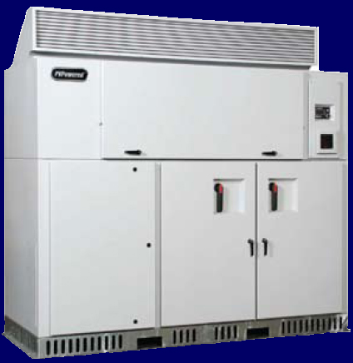
System Inverter
Converts DC electricity to AC electricity

Slide 12
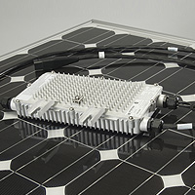
Micro Inverters
A single inverter that is next to or built into the individual PV modules. The micro-inverter converts the dc power at the module rather than at a single large inverter serving many modules.

Slide 13
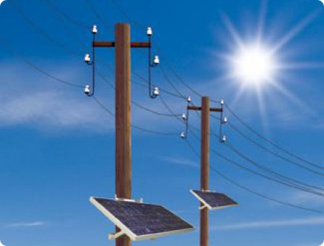
Maybe you’ve seen these?
Some utility companies have mounted solar PV modules on their poles. These modules have micro inverters mounted on the back of the modules.

Slide 14
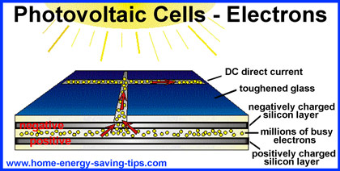
Photovoltaic Cell
A device composed of specially prepared semiconductor material or material combinations exhibiting the ability to convert incident solar energy directly into electrical energy.

Slide 15
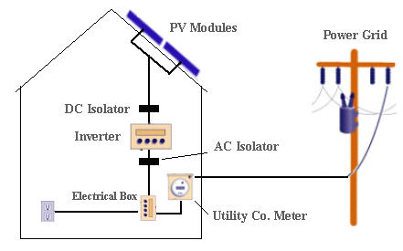
Photovoltaic Systems
An installed aggregate of solar arrays generating power for a given application.
A system may include the following sub-systems:
Support Foundation
Power conditioning and control equipment
Storage
Active Thermal control
Land security systems and buildings
Conduit/wiring
Instrumentation

Slide 16
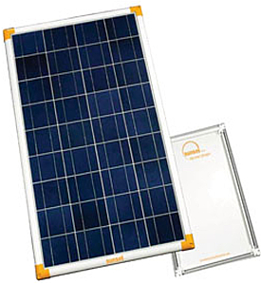
Solar Module/Panel
A collection of solar modules connected in series, in parallel, or in series- parallel combination to provide greater voltage, current, or power than can be furnished by a single solar module.
Solar panels can be provided to furnish any desired voltage, current, or power. They are made up as a complete assembly.
Larger collections of modules are called
solar arrays.

Slide 17
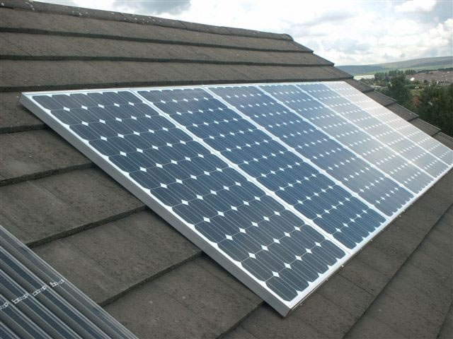
Solar Arrays
Any number of Photovoltaic modules connected together electrically to provide a single electrical output. An array is a mechanically integrated assembly of modules or panels together with support structure (including foundation and other components, as required) to form a free-standing field installed unit that produces DC

Slide 18
Types of Systems
Roof
Ground
Canopy
Building Integrated

Slide 19
Roof Array

Slide 20
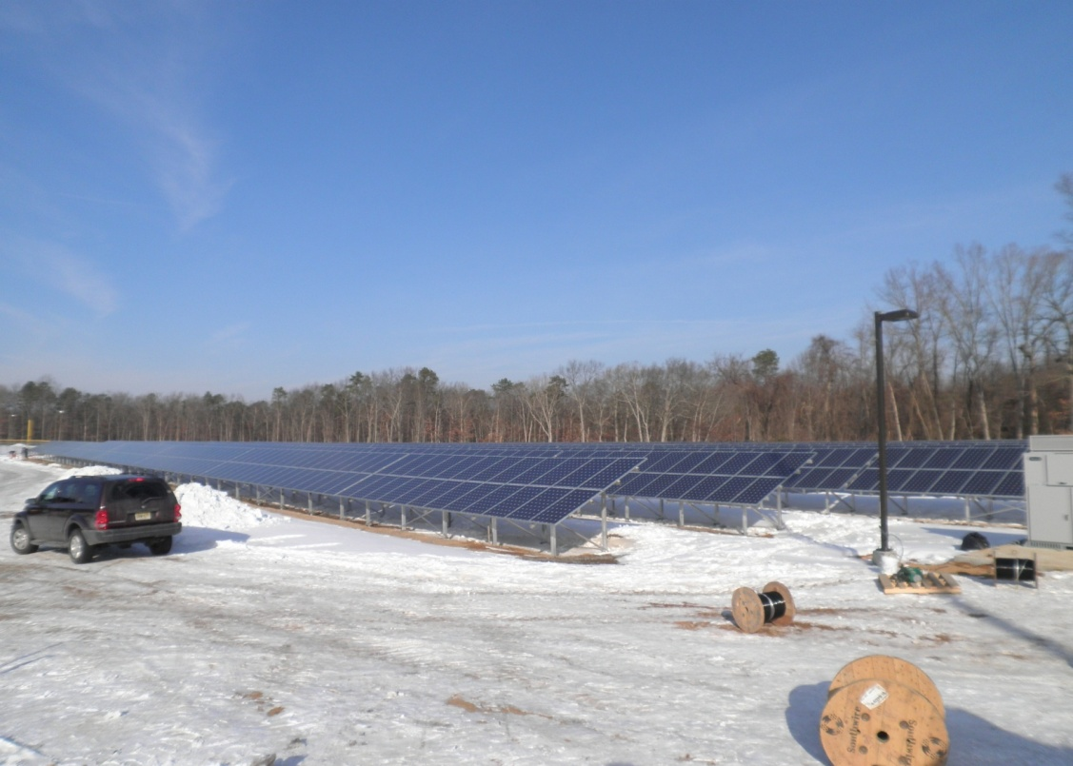
Ground Array
Vegetative growth underneath/around?

Slide 21
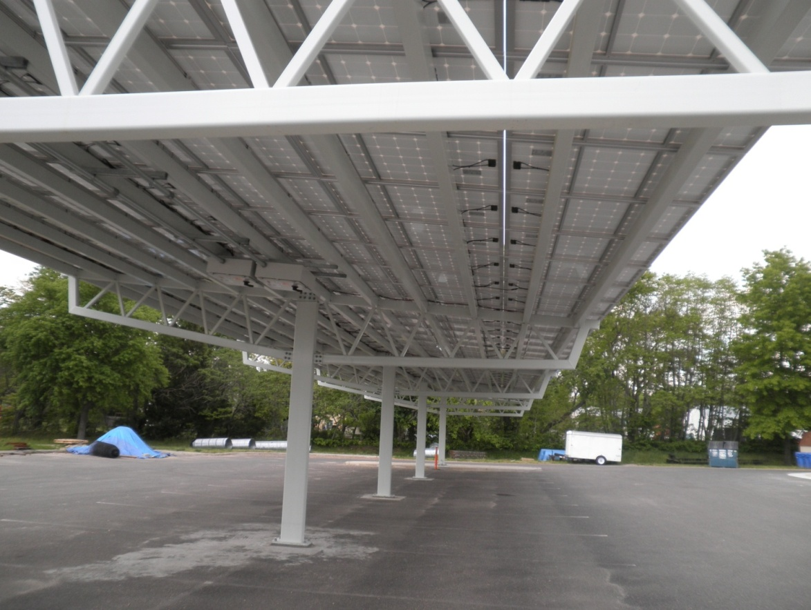
Canopy Array
Vehicles/storage underneath

Slide 22
Building Integrated PV (BIPV)

Slide 23
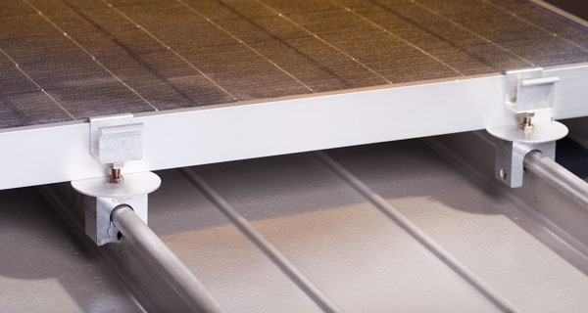
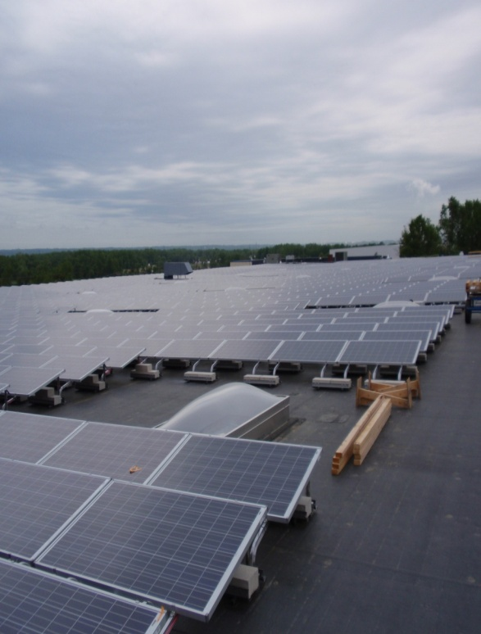
Roof/Fastening Ballasting

Slide 24
Other System Components

Slide 25
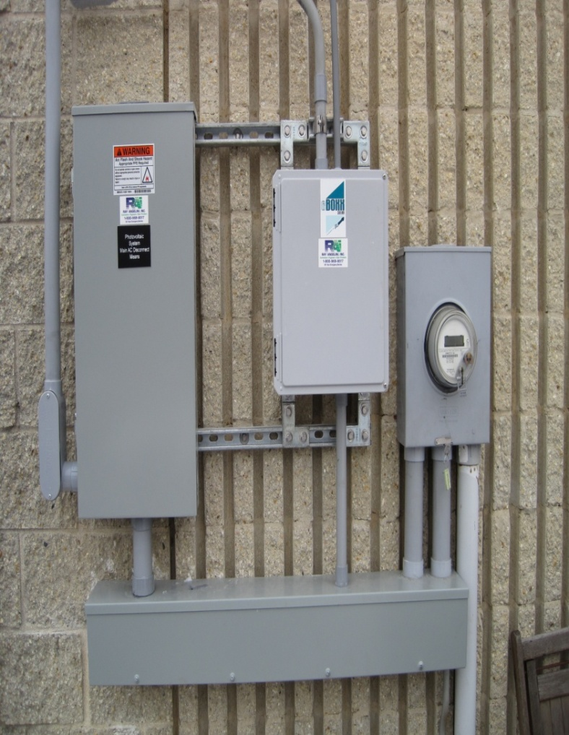
Solar PV Electrical Service Feed

Slide 26
Circuit Breaker Feed

Slide 27
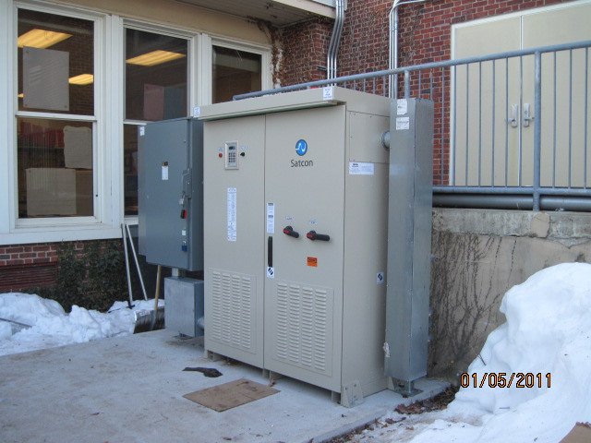
Inverters

Slide 28
Inverter Operating Parameters

Slide 29
Conduit
)

Slide 30
Batteries
Batteries are used most frequently in off-grid PV systems, although batteries may also be used in grid-connected installations where the user wishes to have electricity available when local blackouts occur. Without batteries, a PV system cannot store electricity.
A battery is an electrochemical cell in which an electrical potential (voltage) is generated at the battery terminals by a difference in potential between the positive and negative electrodes. When an electrical load (appliance) is connected to the battery terminals an electrical circuit is completed.

Slide 31
Batteries (cont’d)
A battery cells consists of five major components: electrodes, separators, terminals, electrolysis and a case or enclosure.
Battery banks consist of several batteries wired together with “jumper wires” to achieve the desired voltage and amperage.
There are two terminals per battery, one negative and one positive. The battery may contain a liquid electrolyte; however, it can also be immobilized in a glass mat or suspended in a gel.

Slide 32
Batteries

Slide 33
Cable Tray

Slide 34
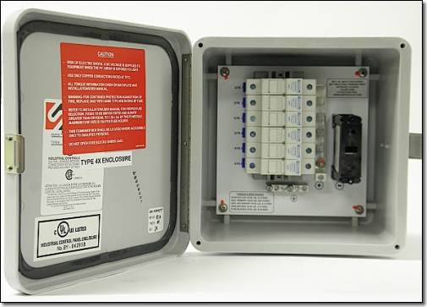
Combiner Box

Slide 35
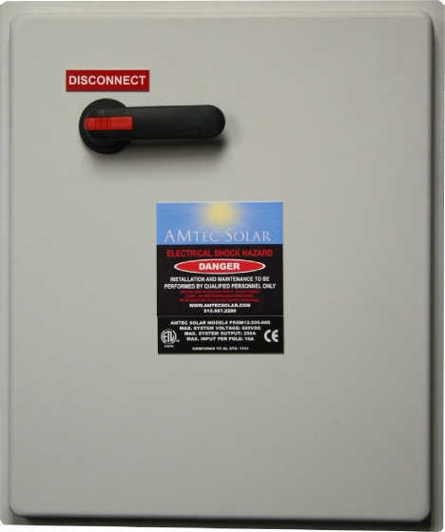
Combiner Box with Disconnect

Slide 36
Strategy and Tactics

Slide 37
Firefighter Safety Points (Fire Engineering, May 2009)
Daytime = Danger; Nighttime = No Hazard
Inform the incident commander that a PV system is present.
Securing the main electrical panel does not shut down the PV panels; in the daytime, electricity continues to flow from the panels to the inverter.
At night, apparatus-mounted scene lighting does not produce enough light to generate a dangerous amount of electricity from the arrays.
Cover all PV panels with 100-percent opaque material to block sunlight and stop the generation of electricity.

Slide 38
Fire Safety Points
Stay away from the panels and conduit. Don’t break, remove, or walk on the PV panels.
SOLAR PV Systems add weight to roof. Each module is approximately 5 feet x 2.5 feet, weighing 60#.

Slide 39
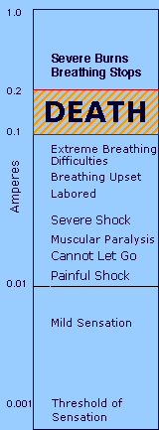
Electricity can cause a variety of effects, ranging from a slight tingling sensation, to involuntary muscle reaction, burns, and death.
 | As shown in the chart, shock is relatively more severe as the current rises. For currents above 10 milliamps, muscular contractions are so strong that the victim cannot let go of the wire that is shocking him. At values as low as 20 milliamps, breathing becomes labored, finally ceasing completely even at values below 75 milliamps.As the current approaches 100 milliamps, ventricular fibrillation of the heart occurs - an uncoordinated twitching of the walls of the heart's ventricles which results in death. Above 200 milliamps, the muscular contractions are so severe that the heart is forcibly clamped during the shock. This clamping protects the heart from going into ventricular fibrillation, and the victim's chances for survival are good.

Slide 40
Size Up/Utilities Group

Slide 41
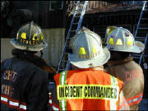
A good “hot lap” or 360 degree view of the building on arrival increases the chance of spotting roof or ground mounted components. IC/Roof division should identify system() as soon as possible.
Indicators of a PV System at Ground Level are conduits, inverters, signs, or switching and any other components that seem different from normal utility systems.
IC should assign a “Utilities Group” as part of ICS. In addition to de-energizing equipment powered by the local utility, the Utility Group must also de-energize electrical circuits leading from the PV system. The Utility group should locate
and disconnect any and all switches in the PV system including switch-gear on the roof, switches on either side of an inverter and any switches in the
connection to the building’s main electrical system. The power disconnects for the PV system components should be located and placed in the “Off” position, and “Lock out/Tag out” measures used. By code, these components should have specific signage or labels designating their location, however, this may not always be the case.

Slide 42
CAUTION!!!
Solar PV Wiring May Remain Energized After Disconnection During Daylight Hours

Slide 43
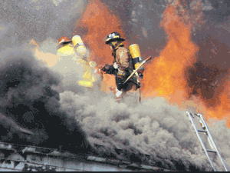
Fire Suppression
If PV System is source of fire, primary concern is protection of structure. Utilize Dry Chemical Extinguishers on any possible energized components.
If Roof material is on fire, utilize a 30 degree fog stream @ 100 psi (little risk of shock).
Burning modules produce toxic vapors. Don full PPE/SCBA.
Priority is to contain fire to array module.
If structure fire, implement structure fire tactics, being keenly aware of SOLAR PV System and work around it, if at all possible.
Only under special circumstances are modules to be removed. If need be, utilize non-conductive tools and insure system is de-energized.
For Ground arrays, utilize a 30 degree fog pattern @ 100 psi at a 30 foot distance.
ALWAYS REMEMBER, SOLAR PANELS ARE ALWAYS “HOT” IN DAYLIGHT!

Slide 44
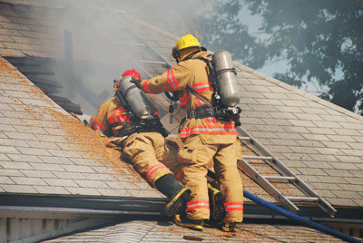
Ventilation
Take into consideration the array’s location and size when performing ventilation operation
Do not remove modules
Do not stand on modules
During cutting operations, stay away from array conduit , as the inverters may be energized.
If the conduit run penetrates the roof, it may or may not be attached to the bottom of the rafters. Keep cuts shallow.
If ventilation is impeded, advise the IC immediately.

Slide 45
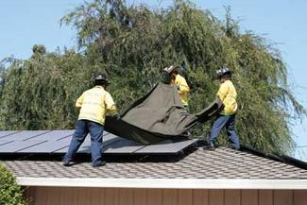
Salvage and Overhaul Ops
If it is a daytime fire and ventilation is not needed or is complete and salvage operations are underway, put a tarp over the array. Covering the entire array with a totally opaque material, such as heavy dark canvas tarps or black plastic. These will prevent the array from generating electricity (blue plastic tarps do not work). The covering material must cover the entire array, including subarrays.

Slide 46
Do not assume any electrical components are safe to touch. Whether it be a fire directly related to the SOLAR PV Array, or the structure itself, exercise caution, and assume that the system is energized..
Residential installations will have pipe/wire, possibly routed in the attic space. The crews inside must be careful when pulling ceilings.
Remember, that in commercial structures, metallic conduits may be used everywhere. If your department carries noncontact voltage detectors, remember that they detect only the presence of AC voltage, not DC voltage.
At all times, avoid contact with the conduit.

Slide 47
After a fire event, assume the conduit and wires inside may have become compromised. When sunlight contacts the array the next day, it could result in some arcing. Recheck a structure in the morning for arcing or rekindling from arcing
Do not re-energize the system until a a qualified solar contractor can respond.

Slide 48
Upcoming IFC Codes 2012
The California Department of Forestry and Fire Protection - Office of the State Fire Marshal (CAL FIRE-OSFM), local Fire Departments (FD), and the solar photovoltaic industry have developed this guideline for installations to increase public safety for all structures equipped with solar photovoltaic systems.
This guideline was developed with safety as the principal objective. The solar photovoltaic industry has been presented with certain limitations in roof installations due to firefighting suppression techniques. The intent of this guideline is to provide the solar photovoltaic industry with information that will aid in the designing, building, and installation of solar photovoltaic systems in a manner that should meet the objectives of both the solar photovoltaic industry and the Fire Service.

Slide 49
The provisions of this guideline, if adopted by the local enforcing agency by local ordinance, is meant to apply to the design, construction and installation of solar photovoltaic systems on buildings regulated by Title 24 of the California Building Standards Codes.
A solar contractor should always contact their local fire department to determine if the means or methods to be used will allow for a safe installation that is acceptable to the fire department and meets local code requirements.

Slide 50
Recommended Reading/Links
CALIFORNIA DEPARTMENT of FORESTRY and FIRE PROTECTION OFFICE OF THE STATE FIRE MARSHAL SOLAR PHOTOVOLTAIC INSTALLATION GUIDELINE (In partnership with interested local fire officials, building officials, and industry representatives) April 22, 2008 (Final Draft)
Fire Fighter Safety and Emergency Response for Solar Power Systems Final Report (An Assistance to Firefighter Grants (AFG) Funded Study Prepared by: Casey C. Grant, P.E. Fire Protection Research Foundation, NFPA
CALFIRE Guidelines:
http://osfm.fire.ca.gov/pdf/reports/
solarphotovoltaicguideline.pdf

Slide 51
Fire Operations for Photovoltaic Emergencies:
http://osfm.fire.ca.gov/training/pdf/
photovoltaics/fire.pdf
The Fire Protection Research Foundation: Fire Fighter Safety and Emergency Response for Solar Power Systems
http://www.nfpa.org/assets/files/PDF/Research/FFTacticsSolarPower.pdf

Slide 52
References
Callan, Michael, “Responding To Utility Emergencies: A Street Smart Approach to Understanding and handling Electrical and Utility Gas Emergencies”, 1st Edition, Red Hat
Publishing, 2004.
Grant, Casey, “Fire Fighter Safety and Emergency Response for Solar Power Systems,”
NFPA, Fire Protection Research Foundation, Quincy MA, May 2010
Slaughter, Rodney, “Fundamentals of Photovoltaics for the Fire Service”, Dragonfly
Communications Network, Corning, CA, September 2006.

Slide 53
References (cont’d)
CAL Fire Office of the State Fire Marshal
“Fire Operations for Photovoltaic Emergencies”.
“Fire Fighter Safety and Emergency Response for Solar Power Systems Final Report”, Quincy MA, May 2010

Slide 55
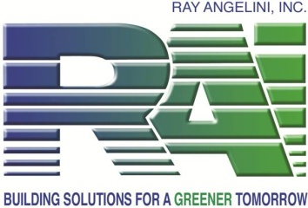
Thank you.
Chris: ctranchina@raiservices.com
Joe : jcamarota@raiservices.com

