Slide 1
Do Now #1
If you had to describe yourself in one word, what would it be?
Please get one of each of the papers at the center table.
OBJ:SWBAT examine and identify with my mission statement to them: To challenge and motivate you, my students, through the various disciplines to become the very best you can be as a unique individual, through your journey in better understanding yourself.
HW #1 – Adult Interview wkst and Sign up at www.everfi.net
Class Codes:
Freshmen – 227412f0
Seniors – bfb0c16e

Slide 2
Do Now #2
What does it mean “to possess good character”?
Please hand in your essays.
OBJ: SWBAT understand the Six Pillars of Character and how they apply in our lives. Intro to Personal Finance.
HW#2 – Choose one of the pillars. Describe a time in your life when you displayed that pillar and when you had not.

Slide 3
Do Now #
Describe an event in your life where you can pinpoint exactly where you were and what you were doing.
OBJ: Given background information on September 11, 2001 SWBAT explain how the Six Pillars of Character/Finance played a role in the lives of citizens by means of writing a four paragraph essay.
HW#3 – Share this message with me on Google Docs:
“Hi Miss Terry! I did it!!”
missterrypffo@gmail.com

Slide 4
Do Now #3
What makes you happy? – Please write your answer on the post it and put it on the paper on the center table.
Obj: SWBAT understand how personal financial decisions are influenced by an individuals interpretation of needs and wants
HW#3 – Share this message with me on Google Docs:
“Hi Miss Terry! I did it!!”
missterrypffo@gmail.com

Slide 5
HI FRESHIES!!!
PLEASE TAKE OUT YOUR BINDERS AND GET READY TO WRITE.
DO YOU HAVE YOUR HOMEWORK?
What HW Miss Terry?
Uh, your definitions….You did them, right?
HAND IT IN!!!

Slide 6
Homeworks….so far
Miss Terry, what am I doing????
WORKING ON YOUR STORY ABOUT A PERSON WITH HIGH WELL BEING!
REMEMBER, YOUR PERSON CAN HAVE SOME STRESS IN THEIR LIFE BUT MAKE SURE THEY HANDLE IT CORRECTLY.
YOU HAVE THE STORY OF HANNAH AND MORGAN AS AN EXAMPLE.
MAKE SURE THAT IT IS AT LEAST 4 PARAGRAPHS.
IT IS DUE BY THE BELL!
IF YOU OWE ANY WORK, KEEP IT!
HW #1 –Adult Interview wkst and Sign up at www.everfi.net
Class Codes:
Freshmen – 227412f0
Seniors – bfb0c16e
HW#2 – Choose one of the pillars. Describe a time in your life when you displayed that pillar and when you had not.
HW#3 – Share this message with me on Google Docs:
“Hi Miss Terry! I did it!!”
missterrypffo@gmail.com
HW# 4 – Write down the following in your binder: 5 Values and 5 major future purchases

Slide 7
Warning!!!!!
You should have a
__________
to be on track to pass this class.
Please do the work to improve your grade!!!!
Warning!!!!!
You should have a
__________
to be on track to pass this class.
Please do the work to improve your grade!!!!

Slide 8
Do Now #4
How would you feel if you won the lottery?
Obj: SWBAT Understand how personal financial decisions are influenced by an individuals interpretation of needs and wants (SAME)
HW# 4 – Write down the following in your binder: 5 Values and 5 major future purchases

Slide 9
WELCOME PARENTS!!!
PERSONAL FINANCE/FRESHMAN ORIENTATION
PERSONAL ECONOMICS
AMANDA TERRY
ROOM 433
732-229-7300 EXT 41433
“THE CHOICES YOU MAKE DICTATE THE LIFE YOU LEAD”
ARE YOU READY FOR YOUR TEST???

Slide 10



What do we need for this class?
The course syllabus can be found on the school website.
Enroll in www.everfi.net... Education is Evolving
EverFi offers students of all ages a digital learning platform that delivers the critical skills that life demands.
The main books are

Slide 11
Do Now #5 – Please take out your papers from last class.
Please complete the side of the worksheet that is entitled “Values Continuum”. It’s on the center table.
Please grab one of each of the worksheets on the table.
OBJ: SWBAT Understand how personal financial decisions are influenced by an individuals interpretation of needs and wants (SAME)
HW – MLK Essay!! Due TODAY. You can type it for extra credit! ☺

Slide 12
Miss Terry, what am I doing????
WORKING ON YOUR STORY ABOUT A PERSON WITH HIGH WELL BEING!
REMEMBER, YOUR PERSON CAN HAVE SOME STRESS IN THEIR LIFE BUT MAKE SURE THEY HANDLE IT CORRECTLY.
YOU HAVE THE STORY OF HANNAH AND MORGAN AS AN EXAMPLE.
MAKE SURE THAT IT IS AT LEAST 4 PARAGRAPHS.
IT IS DUE in 15 minutes!
IF YOU OWE ANY WORK, KEEP IT!
DO NOT FORGET….YOUR BEST FRIEND HOMEWORK IS DUE WEDNESDAY!!!

Slide 13
Do Now #6
Do you remember Show and Tell? What was the purpose?
Please get the papers from the center table.
Obj: SWBAT Understand how personal financial decisions are influenced by an individuals interpretation of needs and wants (SAME)
HW#5 – Computer or Camera Decision Making Grid

Slide 14
Do Now #7
What is the purpose of a financial advisor?
Obj: SWBAT Understand how personal financial decisions are influenced by an individuals interpretation of needs and wants (SAME)
HW#5 – Computer or Camera Decision Making Grid

Slide 15
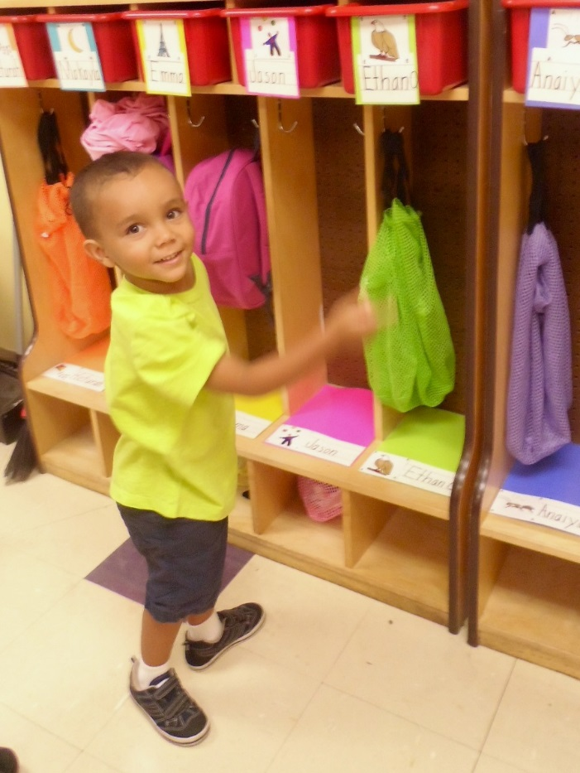
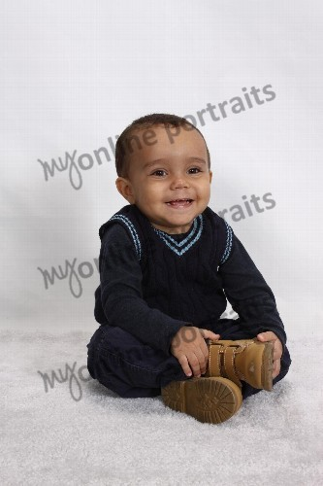
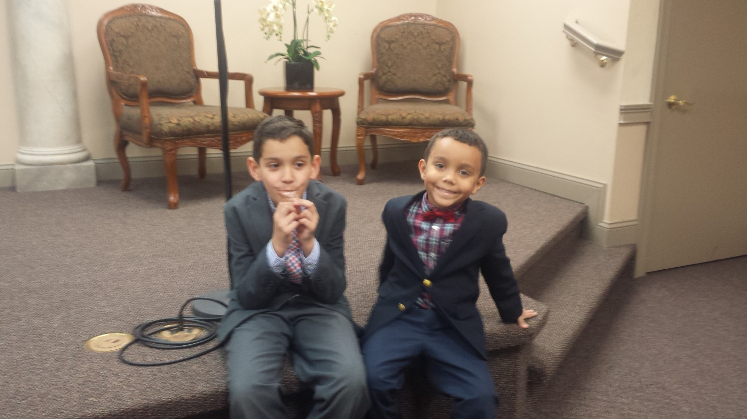
Let’s meet Ethan!!

Slide 16
Format for Ethan Letter –
At least 4 paragraphs
Paragraph 1 – Intro….Introduce yourself to Ethan and explain what you’re about to do for him.
Paragraphs 2&3 (or more) – Explain which decisions you made for Ethan and why you made those decisions.
Paragraph 4 – Conclusion….Let Ethan know that he should always take into account his values, needs and wants and to really consider always making the right decisions and setting goals

Slide 17
WHAT AM I DOING? YOUR UNIT 1 TEST!!!
PART 1 – LETTER TO ETHAN – to be done today!!!
PART 2 – MULTIPLE CHOICE – to be done on separate paper!! Must be handed in today!
PART 3 – COLLAGE – due by Tues Oct. 6th!! I have paper if you need it! ☺
Any work that you owe me!!!
DON’T WASTE YOUR TIME!!!!!!!!!!!!!!!

Slide 18
Do Now #8
How would you define the word “goal”? What feelings are associated with it?
Please get one of each of the papers from the center table.
Have work for me? HAND IT IN!
Obj: SWBAT Understand how personal financial decisions are influenced by an individuals interpretation of needs and wants (SAME)
HW – Work on your collages for the Unit 1 Test – Due by Friday!

Slide 19
WELCOME TO CLASS QUIZ #1
Instructions:
You will have 10 minutes to read over your notes from last class.
Then designate a class captain.
The captain will create a lineup for each question. There should be two people assigned to each question. Everyone must be selected first as a primary answerer before being repeated.
As I go through each question, the primary person will give the answer and the captain will type it. Once this is complete, we will print the results and the entire class will receive the same grade.
Hopefully, you will all work TOGETHER to get the best grade possible! ☺

Slide 20
Do Now #9 - Seniors
Please complete the Educational SMART Goal worksheet. You have 10 minutes.
Take out your notes.
Obj: SWBAT Understand how personal financial decisions are influenced by an individuals interpretation of needs and wants (SAME)
HW#7 – Go to a bank or credit union and get a brochure that describes the features of the bank.

Slide 21
Do Now #11
Take out your cell phones and download a dice rolling app. If you don’t have a cell phone, see me.
DON’T GET TOO COMFORTABLE!!
OBJ: SWBAT define depository institution, explore checking accounts and various savings tools. They will also learn how to effectively complete a check, deposit slip and check register. (SAME)
HW#6 – Complete the checking account packet. And yes, YOU may need to call or go to the bank
!!!!!!!!!!!!!!!!!!!!!!!!DUE TOMORROW!!!!!!!!!!!!!!!!!!!!!!!!!!

Slide 22
Do Now #12
Do you keep track of your money? How?
Please get the papers from the center table.
OBJ:
▪ Evaluate the purpose of an Income and Expense
Statement
▪ Identify sources of income individuals have
▪ Explore typical expenses individuals incur
▪ Create an Income and Expense Statement
HW – Depository Institution Research Due by Monday!
Josie and the Banks – Due by Friday

Slide 23
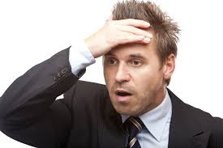
NEED ANOTHER HOMEWORK?
CHECK HERE!!

Slide 24


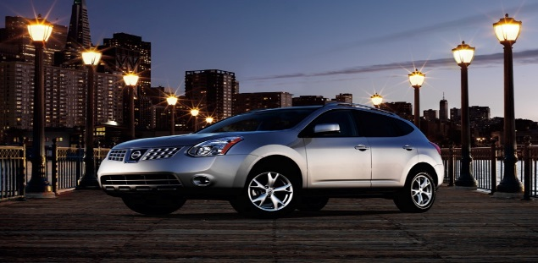
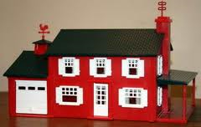

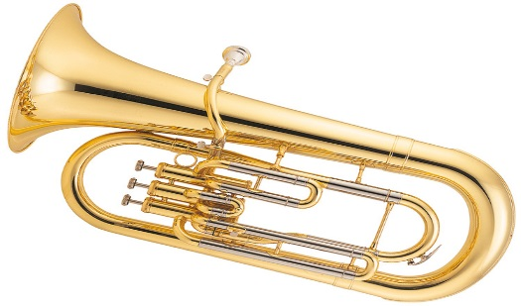
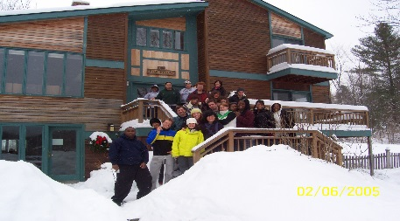


AMANDA TERRY
Religion - it guides every aspect of my life
Family - they are the backbone of everything I do
Friends - they encourage me to continue to give 100%
Work - I feel privileged knowing that I have helped someone else.
Reputation - "A name is to be chosen rather than abundant riches"
Practice diligently and intently with a view
to becoming a member of an orchestra
that I have always hoped to join.
Continue to devote my time and energy
to teaching others about the Bible.
Continue to make progress in making
wise financial decisions.
Long Term Goal -
By December 2014, I would like to have my house 100% paid for and I will do this by paying an extra $200 per month.
Short Term Goal -
By December 2013, I would like to be a part of an orchestra that provides music for various movies and CD's and I will be able to do this by continuously practicing and submitting a recording of my music.

Slide 25
Do Now #13 Please get the papers from the center
QUIZ YOURSELF!
What is the purpose of an Income and Expense Statement?
How do you calculate a Net Gain or Net Loss?
Would your I&E Statement be the same as someone else? Explain?
OBJ: SWBAT define depository institution, explore checking accounts and various methods of tracking their finances.
HW#8 – Complete the checking account packet. And yes, YOU may need to call or go to the bank!!! Due by Friday!!
Don’t forget any work you may owe me.

Slide 26
Do Now #14
So far, you have been a financial advisor for Ethan and Josie. Do you think you have the experience to assist the Evan, Tori, Cody and Carson Family?
Please take the papers from the center table.
OBJ: SWB assessed on their knowledge of the various aspects of Unit 2 – Managing Your Money.
HW#9 – Bankruptcy Article……Due Today!

Slide 27
You need this for your Unit 2 Test
All prefilled notes:
  Intro to depository Institutions
  Basics of Taxes
  Income and Expense
  Statement of Financial position
  Spending Plans
  The Carson Family – Questions, Chart, Story
  Unit 2 Multiple Choice and answer sheet
  Blank Checks

Slide 28
Do Now#15
What do you want to be when you grow up?
Please take out your movie test!
Please get a copy of the worksheets from the center table.
OBJ: SWB assessed on their knowledge of the various aspects of Unit 2 – Managing Your Money. (SAME)
HW – EverFi…due April 1st !………and anything else you may owe me. Remember seniors, the midterm is the week we come back from break. The grade you get, is the grade you get.

Slide 29
Do Now#15
Yesterday was the 3 year anniversary of…….
Please take out your movie test!
Please take out a blank piece of paper.
OBJ: SWBAT explain why a Statement of Financial Position is an important financial planning tool and create a Statement of Financial Position
HW – EverFi…due Nov 9th!………and anything else you may owe me, aka Bankruptcy Article (freshmen)
Remember seniors, the midterm is next week. The grade you get, is the grade you get.

Slide 30
Let’s play a little catch up!! Do you have……
Bank Research Homework? Hand it in!
Bankruptcy article? Hand it in!
Checks Simulation? Hand it in!
Decision Making Quiz? Hand it in!
Buying a computer or camera? Hand it in!
Ethan or the Collage? Hand it in!
Evan, Tory, Cody, the Carson family? Hand it in!
Remember, EverFi is due april 1st!
Any multiple choice stuff? Hand it in!
Movie Test? Hand it in!
Josie and the Banks? Hand it in!
Part 3 to the test (checks)? Hand it in!
Career Project? Due April 5th!!!!!!!!!!!!!!!!!!!!!!!!!!!!!!!!!!!!!!

Slide 31
Do Now #16
How do the six pillars relate to bullying?
OBJ: SWBAT define depository institution, explore checking accounts and various savings tools. They will also learn how to effectively complete a check, deposit slip and check register. (SAME)
HW#10 – Choose a pillar. Find a short article about a teenager displaying that pillar. Answer the 5 W’s: Who, What, When, Where, Why and how can you imitate this person in your own life?

Slide 32
Do Now #
Who is Dr. Seuss? Team up and use your phone to find one quote that he said.
OBJ: SWBAT
▪ Interpret the importance of investing in human capital
▪ Analyze reasons why a person would want to build a career
▪ Explore the relationship between education level and income
HW#1 – Snapshot of Your Future worksheet…….
Carson Family Due Fri (A2 and B) Due Mon (A1)

Slide 33
Do Now #20 – Welcome to the new MP!!
Please get your folders from the center table and the little paper and the blank check.
On the paper given, please explain to me what I (MissTerry) can do for you to help you have a better next marking period. Also, tell me how you plan on improving your performance in all of your classes.
Make sure your name is on it please.
OBJ: Upon completion of this lesson, participants will be able to:
▪ Describe the importance of net worth
▪ Explain why a Statement of Financial Position is an important financial planning tool
▪ Create a Statement of Financial Position
HW#1 – Find song lyrics that talk about money. Print them out and hand in!

Slide 34
Miss Terry’s Email: aterry@longbranch.k12.nj.us
Share on Google Docs
missterrypffo@gmail.com

Slide 35
MP 3 Stats – Period A1
Class average – 69 %
High – 100%
Low - 45%
Why? For some, lack of effort, concentration, disregard for self improvement, laziness, inability to trust your instructor…perhaps your way ISN”T working?
Remind yourselves….come to SAP, put away the cell phones, the late assignments should go away and don’t procrastinate!
Btw, your grade includes extra credit and I dropped the lowest homework grade.
Anything else?

Slide 36
MP 3 Stats – Period B
Class average – 63%
High – 96%
Low - 9%
Why? For some, lack of effort, concentration, disregard for self improvement, laziness, inability to trust your instructor…perhaps your way ISN”T working, still?
Remind yourselves….come to SAP, put away the cell phones, the late assignments should go away and don’t procrastinate!
Btw, your grade includes extra credit and I dropped the lowest homework grade.
Anything else?

Slide 37
MP 3 Stats – Period D
Class average – 74%
High – 94%
Low - 48%
Why? For some, lack of effort, concentration, disregard for self improvement, laziness, inability to trust your instructor …perhaps your way ISN”T working?
Remind yourselves….come to SAP, put away the cell phones, the late assignments should go away and don’t procrastinate!
Btw, your grade includes extra credit and I dropped the lowest homework grade.
Anything else?

Slide 38
MP 3 Stats – Period E1
Class average – 66%
High – 98%
Low - 13%
Why? For some, lack of effort, concentration, disregard for self improvement, laziness, inability to trust your instructor…perhaps your way ISN”T working, still?
Remind yourselves….come to SAP, put away the cell phones, the late assignments should go away and don’t procrastinate!
Btw, your grade includes extra credit and I dropped the lowest homework grade.
Anything else?

Slide 39
MP 3 Stats – Period E2
Class average – 69%
High – 90%
Low - 41%
Why? For some, lack of effort, concentration, disregard for self improvement, laziness, inability to trust your instructor…perhaps your way ISN”T working, still?
Remind yourselves….come to SAP, put away the cell phones, the late assignments should go away and don’t procrastinate!
Btw, your grade includes extra credit and I dropped the lowest homework grade.
Anything else?

Slide 40
Do Now#21
Black Friday is rapidly approaching!! What is your Statement of Financial Position?
Take out your Tori assignment.
SAME!!!!OBJ: Upon completion of this lesson, participants will be able to:
▪ Describe the importance of net worth
▪ Explain why a Statement of Financial Position is an important financial planning tool
▪ Create a Statement of Financial Position
Hw#2 – Snapshot of Your Future Worksheet….due in Wednesday 11/18/15

Slide 41
What Do I Do Now, Miss Terry?
Once you have completed your MC, please bring both questions and answers to me.
You may begin your Carson Family Essay. As per the question page, your letter is to be 5 paragraphs long. Don’t worry! Treat each question as its own paragraph with questions 5 & 6 in paragraph five.
Check your notes! Especially the Spending Plan Notes! The answers are there…how well can you put it into your own words?
Do not forget: the stars that we put in our Carson Family chart are the changes you will make to their spending plan.
When you are done, hand in all parts to the Carson Family - Questions, Chart, Story, and Essay

Slide 42
Interested in Extra Credit?
Need some help? Ask Fatema!!
اكتب بك مقال كارسون الأسرة لمدة 10 نقاط اضافية

Slide 43
Do Now #23
What are some advantages to dropping out of school?
Please take out your Carson notes. Any questions?
I have changed the due date to Monday!
OBJ: SWBAT
Describe benchmarks in the higher education
application process
▪ Analyze personal remediation needs and options
▪ Consider the financial implications of switching majors
and/or colleges once enrolled
HW –Carson Family!! Due Monday!!

Slide 44
Do Now #20 – Welcome to the end of the MP
On the paper given, please explain to me what I (MissTerry) can do for you to help you have a better next marking period. Also, tell me how you plan on improving your performance in all of your classes.
Please take out your binders
OBJ:
Focus on Career Choices pages
HW – Work on EverFi and Final Exam

Slide 45
Do Now #25 - Seniors
Imagine you need a laptop for work. How will you go about buying it?
OBJ: Calculate the approximate cost of higher education necessary for a specific career; Evaluate eligibility requirements for the FAFSA; Recognize loan repayment requirements
HW#3 - Go to www.forbes.com and find the article “7 Financial Decisions Made In Your 30s That May Haunt You In Your 50s”. Read this article and create a comic panel for each of the 7 decisions.

Slide 46
Do Now #25 - Freshmen
What qualities would you look for in an employee?
On the paper provided, submit a classmate’s name to be the center of a small project.
OBJ: SWBAT evaluate the impact of lifelong learning on one’s ability to function as effectively in the workforce. They will also examine the transferable skills of Edmund Dantes in “The Count of Monte Cristo”.
HW#3 – Go to www.forbes.com and find the article “7 Financial Decisions Made In Your 30s That May Haunt You In Your 50s”. Read this article and create a comic panel for each of the 7 decisions. Due by Friday!!!

Slide 47
Get the paper from the center table and take out your calculator
HW - Go to www.forbes.com and find the article “7 Financial Decisions Made In Your 30s That May Haunt You In Your 50s”.
Read this article and create a comic panel for each of the 7 decisions.

Slide 48
Do Now #26
Why do people save? Do you save money?
Which company do you like more: Facebook, Starbucks or Domino’s Pizza?
You will need your calculators today.
Please take out your Perez Family packet. We are finishing it today! (Period D)
OBJ: SWBAT -
Evaluate the importance of saving money
Identify various savings tools used to reach financial goals
Assess different investment strategies to reach financial goals
HW – PowerPoint (continuous) and Forbes Article (Due Friday)

Slide 49
Do Now #27
Which is better: $200/day for 20 days or a penny doubled each day for 20 days?
Which is better: to start saving at the age of 22 and stop after 10 years OR start at the age of 28 and stop after 30 years?
YOU WILL DEF NEED A CALC FOR CLASS TODAY, HOME SLICE!!!
OBJ: (SAME) SWBAT -
Evaluate the importance of saving money
Identify various savings tools used to reach financial goals
Assess different investment strategies to reach financial goals
HW – THERE IS ALWAYS HOMEWORK AND YOU OUGHT TO KNOW WHAT IT IS!!!!!!

Slide 50
Do Now #28
Please analyze the Financial Pyramid. What are some conclusions you can draw from this chart?
OBJ: (SAME) SWBAT -
Evaluate the importance of saving money
Identify various savings tools used to reach financial goals
Assess different investment strategies to reach financial goals
HW – PowerPoint and anything you may owe!

Slide 51
Hello!
Please get your folders and your folders from the center table.
Take out your binders as well.

Slide 52



Slide 53
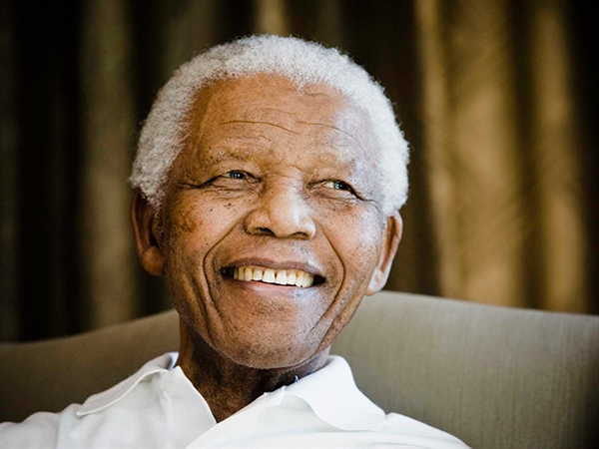
“No one is born hating another person because of the color of his skin, or his background, or his religion. People must learn to hate, and if they can learn to hate, they can be taught to love, for love comes more naturally to the human heart than its opposite.”

Slide 54
Dear LBHS Student,
I, Amanda-Leigh Terry, am a tax paying citizen in the United States. I, as your teacher, am perplexed at the use of my money. Here’s the breakdown:
Cost per student per year: $12,281
Cost per student per day: $68
Cost per student per hour: $10.50
Cost per student per minute: $0.17
Cost per student per for a skinny class (avg 45 min): $7.87
Cost per student per for a block class (avg 90 min): $15.74
Total Cost for my Period D class: $133.79
Total cost for my Period E class: $110.18
In summary,
STOP WASTING MY MONEY!!!!!!!!!!!!!
THANK YOU!

Slide 55
TAKE OUT YOUR NOTES AND YOUR PROJECTS PLEASE!
“What notes Miss Terry?”
Choose To Save
Savings Tools and Chart
Investment Pyramid
“What project Miss Terry?”
Your Career Project that we have been working on for nearly two weeks.
“When is that due Miss Terry?”
Tomorrow!
“Oh no!!! I didn’t start it yet!”
You will have some time today.

Slide 56
Do Now #30
Describe your break in six words. (Like this do now exercise haha!!!)
OBJ: Students will learn the importance of credit cards, as well as their advantages and disadvantages.
HW – NONE!!!! MY TINY GIFT TO YOU!

Slide 57
Do Now #32
“I have time now. All the time in the world.” Is this how you feel about the end of the marking period?
Please pick up one of each paper in the center.
Upon completion of this lesson, participants will be able
to:
▪ Summarize the basic functions of a credit card
▪ Assess the benefits of a credit card if managed responsibly
▪ Analyze a credit card offer and statement
HW – Are you ready for your final exam? Work on it!!!
HW - Research three financial lenders and create a chart listing the lender, the type of credit they offer, the address of the institution within 15 miles of Long Branch and the current interest rate.

Slide 58
WHAT AM I DOING MISS TERRY?
You are reading the story “The Savings Book” and are answering the circled questions: #2 and the Venn Diagram.
Should you complete that in the allotted time, you can work on your essay or powerpoint.

Slide 59
Notes for Credit Card Application
The only real thing is your name and your mom’s maiden name.
The rest you can create.
There is no account number.
SS# format xxx – xx – xxxx
DL# format last name initial followed by 14 digits
You are applying for individual credit.
BTW, we live in NJ.
Employment Income - $xx,xxx per year, Gross
Mortgage/Rent owed to: Terry Loan Co. for $8,000; you pay $250 per month; 7% interest
Don’t forget the back!

Slide 60
PROMISSORY NOTE
A WRITTEN PROMISE TO PAY AT A FIXED OR DETERMINABLE FUTURE TIME A SUM OF MONEY TO A SPECIFIED INDIVIDUAL OR BEARER

Slide 61
Homework Example
 | Lender #1 Address | Lender #2 Address | Lender #3 Address
Home Mortgage | Interest rate | Interest rate | Interest rate
Car Loans | “ | “ | “
College Loans | “ | “ | “
Personal Loans | “ | “ | “
Credit Cards | “ | “ | “

Slide 62
Do Now #33
What is insurance? What does it cover?
Seniors - Complete the chart. Hint: “To the window, to the wall!”
OBJ: SWBAT understand the various forms of insurance and evaluate its role in the life of John Q.
HW – Begin to prepare for all of your midterms!!!!! And complete any makeup work!!!

Slide 63
Do Now #34 – start of the 3rd MP
Define “vision” and “energy” in your own words.
How did we do? Let’s discuss
some data!!
OBJ: SWBAT define, examine, and determine the importance of developing a vision for the future and analyze various ways of making choices.
HW#1 - Bring me something that flies.

Slide 64
Personal Finance/ Freshman Orientation
Midterm Stats
…..how many have now decided to get a binder (like I had asked you to in September) and are going to take better notes?!
Thought the midterm was difficult…..the final will take about 3 weeks to complete!
Have you thought about how you’re going to FIX your life?????? I can help….but you need to take the first step!!!
One of my new kids did better than 13 of my “old” kids….shameful…….and disgraceful.

Slide 65
Do Now #35
Please take out your Credit Cards Note taking guide.
BOYS: you are X’s
GIRLS: you are O’s
OBJ: SWBAT define, examine, and determine the importance of developing a vision for the future and analyze various ways of making choices. (SAME)
HW#2 – Listen to or read the lyrics to the song “We Shall Be Free” by Garth Brooks. How does this compare to Martin Luther King’s “I Have a Dream” speech? Include quotes from both passages while answering.
Due on FEB 17th!

Slide 66
Do Now #36
Please pick up the papers and your folder from the center table.
You have been given a set of pictures. Please go around the room, identifying the pictures.
Please take out your packet of definitions. You will need these to complete your notes.
HW#2 – Listen to or read the lyrics to the song “We Shall Be Free” by Garth Brooks. How does this compare to Martin Luther King’s “I Have a Dream” speech? Include quotes from both passages while answering.
Due TODAY!
DON’T FORGET: YOUR MLK ESSAY IS DUE ON FRIDAY!!!!!!

Slide 67
Do Now #37
Think about the last item you purchased. Was it an impulse buy or did you comparison shop?
Write these definitions down:
Impulse buying - Unplanned buying, where little consideration of the product occurs; immediate gratification; “emotional buying”
Comparison shopping – A careful consideration and evaluation of the product’s features, price and quality; “rational buying”
OBJ: SWBAT
▪ Identify the benefits of comparison shopping ▪ Explore product features that should be considered before making spending decisions ▪ Apply consumer shopping skills
HW – For your parents: Budgeting worksheet…….you have two classes to get this completed

Slide 68
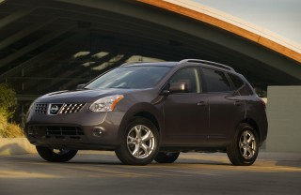

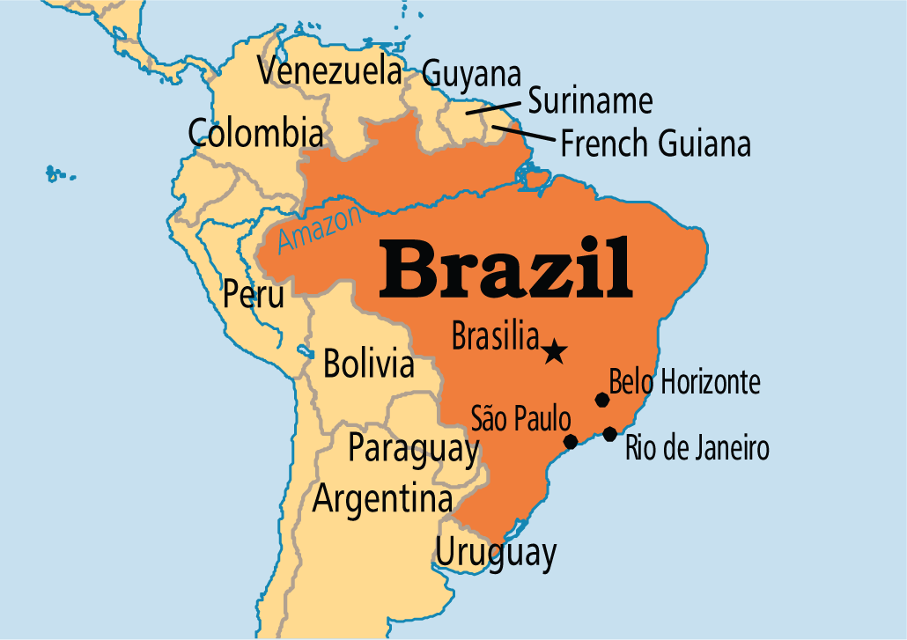
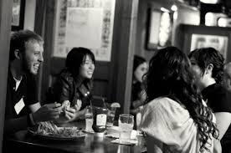
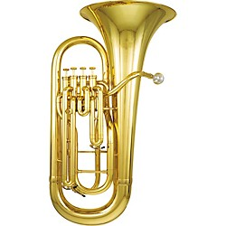

Miss Terry’s Spending Habits
Impulse Buy
Comparison Shop

Slide 69
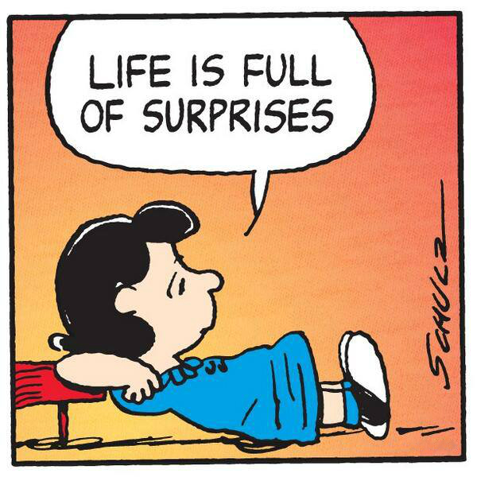
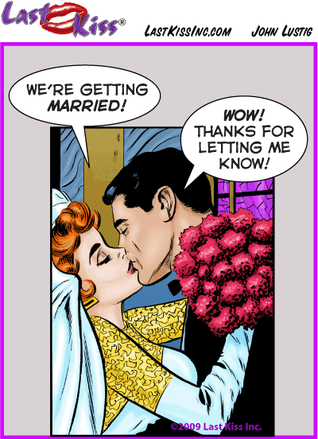

ARE YOU READY FOR YOUR NEW LIFE?
DO I HAVE KIDS?
AM I MARRIED?

Slide 70
Decision Making
Process
It guides individuals to think through all components of making a good decision
STEPS:
  1. Identify the problem
  2. List alternatives
  3. State your Criteria
  4. Evaluate your Alternatives
  5. Make a decision and evaluate the results.

Slide 71
Please hand this in!!!
“Vision without action is merely a dream. Action without vision just passes the time. Vision with action can change the world.”
Joel A. Barker
Where did you hear this quote?
How does this quote fit in with our recent definitions?

Slide 72
DON’T FORGET!!
The next cut off date is March 2nd
Your Garth brooks/ Martin Luther King homework is due tomorrow the 17th
Your MLK essay is due by the 19th. It must be typed!!!!!
Right now you are working on your acrostics. At least one is due before you walk out of here!
Thanks!!

Slide 73
Do Now #38
Do you believe that having plenty of money would solve all your problems?
Please get the three papers from the center table. Do not write your name on them.
OBJ: SWBAT analyze the methods to success and the effects it can have on mankind.
HW – Continue Working on your Budget Projects
OWE ME WORK? Please hand it in.
I can begin grading your envelopes.

Slide 74
Do Now #39
Please get a Possibilities book from the center. Take out a blank piece of paper.
OBJ: SWBAT realize that success comes from having a vision for oneself and combining this with action.
HW – BUDGET PROJECT AND MAKE UP WORK!!!!!!!!!!!!!!!!!

Slide 75
What are we doing, Miss Terry?
Working on your Budget Project
Page 14 (in the black box) from the blue packet
If you don’t have the blue packet, it’s on page 14 of Career Choices (big book)

Slide 76
Palavras dificeis!!!
Jay’s Group | Marvin’s Group | George’s Group with Dan
Rakishly | Turret | grossly
Aimlessly | Hastily | Distraught
Ductal | Coreopsis | insolent
Derisive | Referendum | Insinuatingly
Pandemonium | Bedlam | Cur
Cannonading | Disdainful | Inscrutable

Slide 77
Do Now #39
What are you like when you are “normal”?
Get one of each of the papers at the front desk. On the paper given, please write your name, date, and in the center of the next line “The Shelter”.
OBJ: PPT’s and SWBAT gain further insight into themselves by means of “The Shelter”
HW – Complete any missing assignments. Check with all of your classes to make sure you are passing.

Slide 78
This is your assignment for today. Please don’t waste any time.
Focus on these assignments. They will be graded.
Read Career Choices book page 30. Complete the worksheet “Work Values Survey”. Write a one paragraph response that reflects your opinion about your results. Include in your paragraph a job that would best suit your value and provide an example from your life where you exhibited that value. Remember, you will need this for your PowerPoint.
Read Possibilities page 172 and answer the 8 questions on page 173. Also, on half an index card, draw “Hope”.
Read Career Choices pages 50 – 51. Complete the message center activity from page 52 into your notebooks. Remember, you will need this for your PowerPoint.
You will also need your completed Bull’s Eye Chart for your PowerPoint.
Continue working on your PowerPoints. Due March 27th!
You can also work on any missing assignments and complete the packet. The essay and chart should have already been sent to me through Google Docs.
You have until 8:45. At that time, take out your “What Do You Think?” papers

Slide 79
Assignments continued…..
All 3 parts of “Meet The Robinsons” need to be handed in by Wednesday March 18th.
I’m still accepting Vision and Energy acrostics!!
“Success” Poster
Budget packet! Even if you didn’t finish it, I need the folder!
Richard Cory!! The poor guy……can’t even get people to write about him….
The Shelter! It’s four simple questions. We can do this!
Continue to ask your parents why they work!
EVERFI is due April 10th!!!
The end of the Marking period (for us) is April 2nd!!!!!!!!

Slide 80
Do Now #40
Please complete the student side of the personality worksheet
Get a Possibilities book and a Choices book.
OBJ: SWBAT analyze themselves for certain behavioral traits and then use those traits to work together to accomplish various assignments.
HW – Autobiography PowerPoints and homework for parents

Slide 81
Do Now #40 – day 2
Please get a Possibilities book and a blank piece of paper.
Sit quietly.
OBJ: Same
HW – Autobiography PowerPoints and homework for parents

Slide 82
Do Now #41
How important is a person’s name?
Please get a take out your autobiography PowerPoint notes. Get a Possibilities book please.
OBJ: SW analyze the significance of one’s name and how it affects success.
HW – Autobiography PowerPoints…….do you have the worksheet from your parents?

Slide 83
Do Now #40 – 9th
Please write this in your binders
Name - A word or phrase that constitutes a distinctive designation of a person, place, animal, plant, or other object. It can also mean person’s reputation or the person himself.
Please get a Possibilities book as well.

Slide 84
Do Now #42
Please get a Choices book and a Possibilities book.
Please take out your binders.
OBJ: SW analyze the significance of one’s name and how it affects success. As well as discuss how to overcome excuses.
HW – Complete your PowerPoints . They are due by March 31st.

Slide 85
What are we doing??????????????
Possibilities page 214 – 215
Answer the 10 questions in your notes.
.tnemngissa txen eht rof htiw pu rentrap ot ekil dluow uoy ohw tuoba knihT.

Slide 86
With a Partner …….or by yourself
Choices Book 204-206
Read and choose 1
Answer the first question
Create a story where the characters meet up 15 years later and describe their lives to each other.
Submit before you leave.

Slide 87
Do Now #43
How much do you think a bad habit costs per day? For example, cigarettes.
Please get a Choices book and a Possibilities book.
Please take out your binders.
OBJ: SWBAT comprehend the financial costs of bad habits and its effect on their future.
HW - PowerPoints

Slide 88
Your Assignment!
Today you have the test for the movie.
Please write down your own PERSONAL answers!
When you are done, complete pages 63, 126-131 of the blue packet in your binders.

Slide 89
What do these people have in common with you?
https://www.youtube.com/watch?v=Twt9rptcieM
How about this artist?
https://www.youtube.com/watch?v=xNaA9wUo6GE
Please get your manila folders.
OBJ: SW complete the budget project packet and begin working on essay.
HW#5 – Complete essay by March 18th – MIDNIGHT!!! That means it should at least be done by March 17th 11:59pm!!!

Slide 90
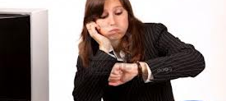
I’ll wait…..it’ll be rude of me to interrupt.

Slide 91
Do Now #44
Describe your spring break in 6 words. No more, no less.
Please get a Choices book, your folder and take out your binder.
OBJ: SWBAT understand the impact Maslow and Gardner have on their identity and self esteem.
HW – Practice saying your Autobiography PowerPoint in front of the mirror. ☺ Don’t worry! You’ll do fine!

Slide 92
Maslow
http://www.youtube.com/watch?v=x2-MCPa_3rU
What do you notice in this scene? What human needs are shown?

Slide 93
Do Now #45
Fill in the blank Maslow Triangle. Identify which level of Maslow’s Triangle Miss Rosie falls under? How about the poet? How about you?
Please answer on the paper provided.
OBJ: SWBAT understand the impact Maslow and Gardner have on their identity and self esteem. Student presentations.
HW – NONE!!! Unless you owe me work…….probably the last time this will happen.

Slide 94
Do Now #46
How intelligent are you?
Please take two sheets from the center table.
OBJ: SWBAT understand the impact Maslow and Gardner have on their identity and self esteem. Student presentations.
HW #1 – Intelligence Superhero! Must represent someone very special to you. Make sure your picture is labeled with the name of the person as well as the type of intelligence they fall under.

Slide 95
Please take out your quiz from yesterday and the two papers with the circles.
Please choose a superhero from the center table.
HW – Intelligence Superhero! Must represent someone very special to you. Make sure your picture is labeled with the name of the person as well as the type of intelligence they fall under.

Slide 96
The Shelter by
Rod Serling
Please answer the following questions.
#1 - How can we relate “The Shelter” to our lives, in particular, to our attitude towards school?
#2 – Sometimes we say things we don’t mean especially to our closest friends. How can we avoid making that mistake?
#3 – Which character do you relate to and why – Dr. William Stockton, Jerry, Dr Wife (Grace), Frank, or Marty
#4 –William says “I wonder if we weren’t destroyed without it (the bomb).” What is the significance of this statement?

Slide 97
Do Now #47
Wednesday was………………….Which of the Six Pillars applies?
Please take out your notebook and take out your MI quiz.
OBJ: SWBAT discuss the various facets of communication: verbal, non-verbal and written.
HW#2 – Helen Keller was an amazing role model despite her disabilities. Who is your role model and why? Explain in no less than a paragraph.

Slide 98
Various Assignments – These four were done separately but count as one grade.
Intelligence Superhero! Must represent someone very special to you. Make sure your picture is labeled with the name of the person as well as the type of intelligence they fall under.
What’s in a name? - Worksheet
Career Choices pages 203 – 206 – Using your given character, write the story of their life 15 years after the account ends.
Possibilities book “Hope” and “A Dream Deferred” – answer the questions that follow each poem

Slide 99
Do Now #49
Identify one positive quality to describe yourself.
Please take out your white paper. We will be creating monuments. Keep in mind the size, location, quality you possess, materials needed when creating your monument.
OBJ: SWBAT discuss the various facets of communication: verbal, non-verbal and written.
HW - Any final make up work not completed in class.

Slide 100
Please get a Career Choices book and have your notebook ready.
In your notebook, please write “Self Appraisal Survey” on a blank page.

Slide 101
Self-Appraisal Survey
The purpose of this survey is to determine your susceptibility to being a source of communication breakdown. Since no one but you will see the results of this questionnaire, answer the questions as honestly as possible. Respond not as you would like to be seen as a communicator but as you really are. Indicate how frequently you engage in the following behaviors when communicating with another person or persons.
Use this scale to describe your behavior.
4 – I always do this.
3 – I often do this.
2 – I sometimes do this.
1 – I seldom do this.
0 – I never do this.
TOTAL SCORE

Slide 102
1. When I have something to say, I am open and honest about my need to say it.
2. I communicate with an awareness that the words I choose may not mean the same thing to other people that they do to me.
3. I recognize that the message I receive may not be the same one the other person intended to send.

Slide 103
4. Before I communicate, I ask myself questions about who my receiver is and how that will affect his or her reception of my message.
5. As I communicate to someone, I keep a watchful eye and ear out for an indication that I am understood.
6. I make my messages as brief and to the point as possible

Slide 104
7. I consciously avoid the use of jargon with those who may not understand it.
8. I consciously avoid the use of slang words and colloquialisms with those who may be put off by them.
9. I try not to use red-flag words (words that might trigger an emotional response) that may upset or distract the receiver of my message.

Slide 105
10. I recognize that how I say something is just as important as what I say.
11. I analyze my communication style to determine what nonverbal messages I send and how well they conform to the meaning I desire to get across.
12. I carefully consider whether my message would be best understood by my receiver in a face-to-face meeting, over the telephone, or in writing.

Slide 106
13. I form opinions about what others say to me based on what I hear them saying rather than what I think of them as a person.
14. I make a genuine effort to listen to ideas with which I don't agree.
15. I look for ways to improve my listening skills.

Slide 107
Analyze Survey Results
Find your score on the following table.
Score | Interpretations
50 – 60 | Are you sure you were honest? If so, you are an extremely effective communicator who almost never contributes to misunderstanding.
40 – 49 | You are an effective communicator who only infrequently causes communication breakdown. The goal of these exercises is to move everyone up to this level.
30 – 39 | You are an above average communicator with occasional lapses. You cause some misunderstandings but less than your share.
20 – 29 | Many people (at least those who are honest) fall into this category. While things could be worse, there is much room for improvement in your communication style. The goal of these exercises is to move you to a higher category.
10 – 19 | You are a frequent source of communication problems. Enthusiastically tackle the rest of these exercises and consider their implications for you personally.
Less Than 9 | Your honesty is commendable, but it will take more than honesty to improve your communication effectiveness. Consider taking a communication course.

Slide 108
Would you ever think that you have something in common with a millionaire?
Please get into groups of four.
PLEASE GET A CHOICES BOOK AND HAVE YOUR BINDER READY

Slide 109
MP 4 Assignments
Dr. Dre – Color two pictures that represent the articles.
Miss Rosie – Possibilities page 87 #1-4,6
Communication Article – Read the article and answer 5 questions.
Superhero – Color a superhero. Identify who it is and what Intelligence they possess
Autobiography Powerpoint
Role Model – Who is it and explain in a paragraph why
Argument – Draw a picture of the worst argument you’ve had, who is in it and what was the reason for it.

Slide 110
Communication
Helen Keller 1880 – 1968
1. https://www.youtube.com/watch?v=GbO3W18ndZY
2. https://www.youtube.com/watch?v=Dvq5aQr1eh0
3. https://www.youtube.com/watch?v=lUV65sV8nu0

Slide 111
Body Language
Strictly Ballroom
http://www.youtube.com/watch?v=NYeBLcAwX1A

Slide 112



Cast overview, first billed only:
 | Mark Wahlberg | ... | Vince Papale
 | Greg Kinnear | ... | Dick Vermeil
 | Elizabeth Banks | ... | Janet Cantrell
 | Kevin Conway | ... | Frank Papale
 | Michael Rispoli | ... | Max Cantrell
 | Kirk Acevedo | ... | Tommy
 | Dov Davidoff | ... | Johnny
 | Michael Kelly | ... | Pete
Cast

Slide 113
Individual Assignment
Today, you will be working on your own to accomplish the following assignments:
Get one of each worksheet from the front.
Read the Malcolm Gladwell article. Take notes!! You have a quiz next class.
Complete both sides of the What’s Your Excuse worksheet.
Poss book page 172 #1-8
Poss book page 212 #1,2,6,7
Thanks! I’m still accepting projects!

Slide 114
Do Now #50
Please complete the short Entrepreneur worksheet, located on the center table.
Take out your “Invincible” Movie test, your entrepreneur Project paper and your What Do You Think paper please.
If you need another WDYT, it’s on the center table.
OBJ: SWBAT assess the meaning of entrepreneur and determine how associated traits can promote self worth.
HW – Entrepreneur Project

Slide 115
Hi!
Please take out your strengths and weaknesses worksheet!

Slide 116
Malcolm Gladwell Quiz
Please answer the following on separate paper.
According to Gladwell, why isn’t David considered an underdog?
Name one person Gladwell drew his experiences from for his book and describe what happened to her.
What is Gladwell’s objective for his book?
Who/what is the “Goliath” in your life and how can you overcome this seemingly insurmountable adversity?
Gladwell states that “in every crisis there is an incredible opportunity for growth”. How can the occurrence of Superstorm Sandy relate to this thought?
BONUS! Name one other book Malcolm Gladwell wrote.

Slide 117
Entrepreneur Project Directions
By now, you should have received the outline for this project.
You will allowed to work with ANY of Ms. Terry’s or Mr. Smiga’s students in Freshman Orientation. The maximum amount of group member is 5.
Carefully read the tasks and the requirements. As you see, this is worth 2 grades: Formative and Summative
Take note that the assignment is to be sent through Google Drive to both Smiga and Terry.
The requirements refer to Gardner’s Intelligences, Transferable Skills, Six E’s of excellence and the Six Pillars of Character. Don’t fret! All of this information you already have in your binder. ☺
Any further questions, ask Smiga.
Due by MAY 15th!!!!!!!!!!!!!!!!!!!!!!!!!!!!!!!!!!!!!!!

Slide 118
Do Now #51
Please find your groups for your mini project. Take one of the entrepreneur traits and homework sheets from the center table.
Please take out your what do you think paper.
Please hand in your Invincible test.
OBJ: SWBAT assess the meaning of entrepreneur and determine how associated traits can promote self worth.
HW – Ask a parent: If you could go back and speak to your 15 year old self, what would you say.

Slide 119
Do Now #52
Name 3 important aspects of a job interview.
Please take out your WDYT paper.
OBJ: SWB discussing various aspects of the interview process.
HW – Check your binder for all ALL of your Do Now’s and objectives

Slide 120
Do Now #53
“I have time now. All the time in the world.” Is this how you feel about the end of school?
Please get your folder from the center table.
You need a few pieces of lined paper and your brain.
OBJ: SW begin part of the final exam with an examination of various aspects of the job application.
HW – Begin typing your Cover Letter/ Complete the Eminem Assignment

Slide 121
ASSIGNMENT!
Write a paragraph explaining what you would change if you could go back to the beginning of your entrepreneur project and start all over.
Write a paragraph explaining what you would change if you could go back to the beginning of the school year and start all over.
Be completely honest! And make sure you write a paragraph for each!!!

Slide 122
Well, son, I'll tell you:
Life for me ain't been no crystal stair.
It's had tacks in it,
And splinters,
And boards torn up,
And places with no carpet on the floor—
Bare.
But all the time
I'se been a-climbin' on,
And reachin' landin's,
And turnin' corners,
And sometimes goin' in the dark
Where there ain't been no light.
So, boy, don't you turn back.
Don't you set down on the steps.
'Cause you finds it's kinder hard.
Don't you fall now—
For I'se still goin', honey,
I'se still climbin',
And life for me ain't been no crystal stair.
Langston Hughes
Well, son, I'll tell you:
Life for me ain't been no crystal stair.
It's had tacks in it,
And splinters,
And boards torn up,
And places with no carpet on the floor—
Bare.
But all the time
I'se been a-climbin' on,
And reachin' landin's,
And turnin' corners,
And sometimes goin' in the dark
Where there ain't been no light.
So, boy, don't you turn back.
Don't you set down on the steps.
'Cause you finds it's kinder hard.
Don't you fall now—
For I'se still goin', honey,
I'se still climbin',
And life for me ain't been no crystal stair.
Langston Hughes

Slide 123
Answer the following questions.
Who is the speaker in this poem?
What is the situation?
What advice does the mother give to her son?
What image does the crystal stair evoke?
How does the mother describe the circumstance of her life?
Despite the obstacles, what is the mother encouraging her son to do?
How is this mother a positive role model?
Why do think that some people persist and succeed despite all odds?
What advice do your loved ones give to you?
Can you think of friends or a member of your family who have pushed on when all odds were stacked against them? What is their experience and how did they succeed?

Slide 124
Do Now#54
Please write down the following definition:
Epitaph – An inscription on or at a tomb in memory of the one buried there.
Please take out your life and job that you received last class. Also take out your notebook.
OBJ: Students will continue working on the final exam. They will also continue the film “Renaissance Man”.
HW – Define the following terms: Kaffeelatsch, Oeuvre, Dotage, and Satirical

Slide 125
Do Now #55
Using the articles provided, please answer the following questions into your notebook. Make the heading of your notes “Various Articles”.
What is the average cost to raise a kid?
Jamie Q.’s family spent an exorbitant amount of money for his rehabilitation. What did his wife say as to why they would ever do this for him?
In the article 7 Reasons Why Failure Is A Good Thing, how does it explain how failure actually leads to success?
True or False: Failure helps you grow.
OBJ: Continue working on the final exam and Renaissance Man.
HW – Answer this question: Who is Barbara Walters and when did she retire?

Slide 126
Do Now #5
We have 5 classes left! What would you like to know about the exam? Each group can ask 3 questions.
OBJ: Students will continue working on the final exam. They will also begin a film “Renaissance Man”.
HW – Continue working on missing assignments and final exam!

Slide 127
PLEASE GET…..
Your Folder (on table)
Your Binder
A Yellow Paper (on table)`
A Writing Implement
Your Brain

Slide 128
SENIORS! And juniors and sophomore….
If you have finished your exam, please sit on the window side of the class.
If you have not, sit on the cabinet side.
Please make sure you have handed in the following:
What Do You Think paper
Your green folder
Any extra credit you have done
All parts to your Final Exam
If you have brought in anything for the class, please place it on the back table.
Thank you!

Slide 129
FINAL EXAM REVIEW
WELL, THE TIME HAS ARRIVED TO REVIEW FOR YOUR FINAL EXAM. PLEASE HAVE PAPER AND PEN READY TO TAKE NOTES ON WHAT YOU NEED.
Bring a pen or pencil. The pen must be black or blue.
Bring your binder. If you don’t have one……….
Your phone will be collected. The wise course to take would be to leave it in your locker.
You will only have 1 hour to answer 100 questions. Bring your brain!
The second hour, we will be creating a business card and tying up any loose ends with what we’ve been working on.
Double check to make sure you have sent me everything : Brochure, Resume, Cover Letter and Thank You Letter. You should have also handed in your job Application.

Slide 130
SPECIFIC INFORMATION – this stuff is on the test!
Possibilities book pages
Any movies we have watched – Invincible, Renaissance Man, Pay it Forward, John Q
Budget Project
Six Pillars of Character
Articles we have read – Barbara Walters, Cost of a Kid, The two drug articles, 7 reasons for failure, The communication process, Malcolm Gladwell
And other stuff………

Slide 131
Which Do Now’s do I need?
Hint: You should probably write this stuff down just in case you don’t already have it…..which you should. I’m just sayin’.
Do Now #37 - Why do people work?
Do Now #41 - How important is a person’s name?
Do Now #50 - Please complete the short Entrepreneur worksheet. Take out your Invincible questions.
Please take out your movie answers and final exam stuff.

