Slide 1
America’s History, 8th Edition, Chapter 16 Review Video
www.Apushreview.com
Religion and Reform (1800 – 1860)
Check out the description for videos that match up with the new curriculum.

Slide 2
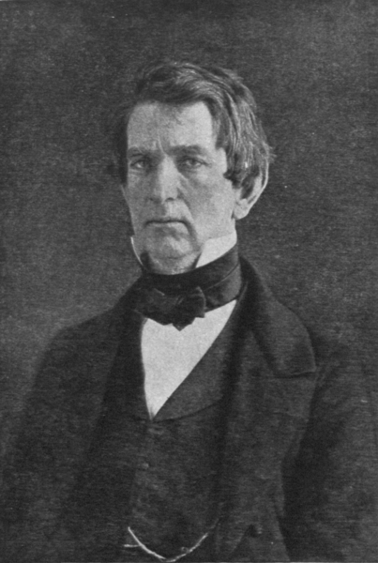
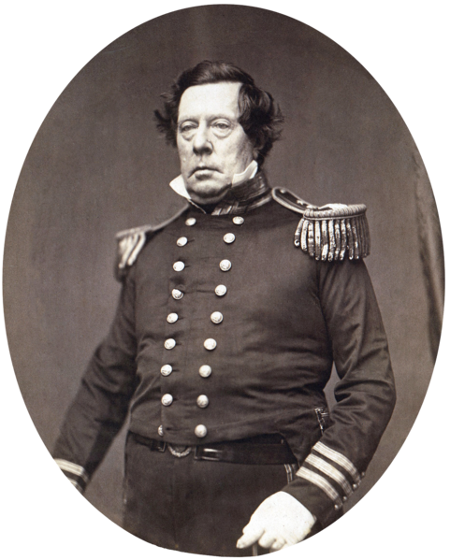
The Republican Vision
Congress during the Civil War:
Created a new national banking system
Instituted a protective tariff – Republicans want to Raise
The New Union and the World:
Post Civil War, America sought to extend beyond its borders
Japan – Matthew Perry and the Treaty of Kanagawa – US could refuel ships, later could trade
Most Americans did not want conquest, but rather advocated increased trade
Burlingame Treaty – protected US missionaries in China, emigration of Chinese to US (cheap labor)
“Seward’s Folly” – US purchased Alaska from Russia, later proved to be valuable

Slide 3
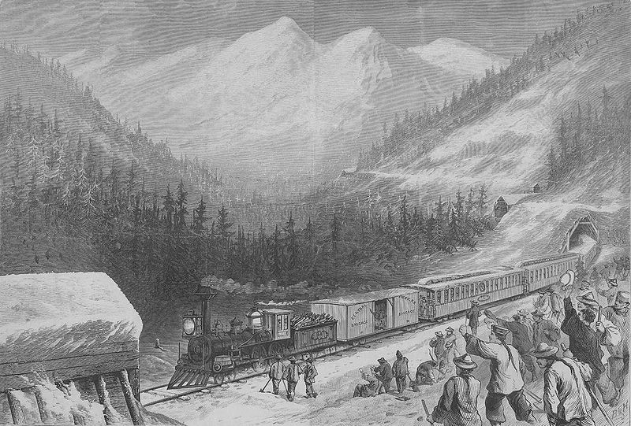
The Republican Vision Cont.
Integrating the National Economy:
RRs – began in the 1830s, transcontinental RR was complete in 1869
In the West, Chinese built many RRs
Federal government gave loans, subsidies, and land grants
Tariffs and Economic Growth:
Tariff – tax on imported goods (largest source of revenue for the government)
Republicans favored tariffs, protect American industries
The Role of Courts:
Munn v. Illinois – states could regulate certain businesses (RRs); later overturned
Many Mexican Americans were forced to leave land in the southwest
Silver and Gold:
US joined the Gold Standard in the 1870s (backing paper $ with gold)
Hurt those in debt (less $ in circulation)
Will become a major issue of the 1890s

Slide 4
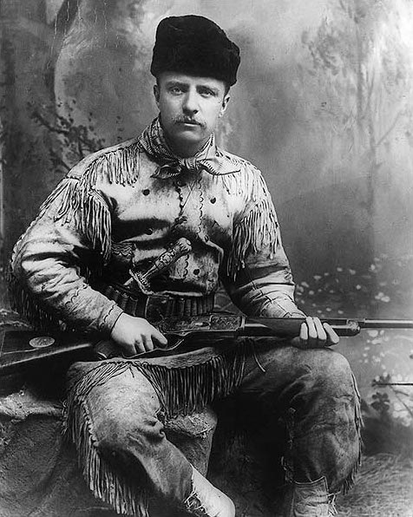
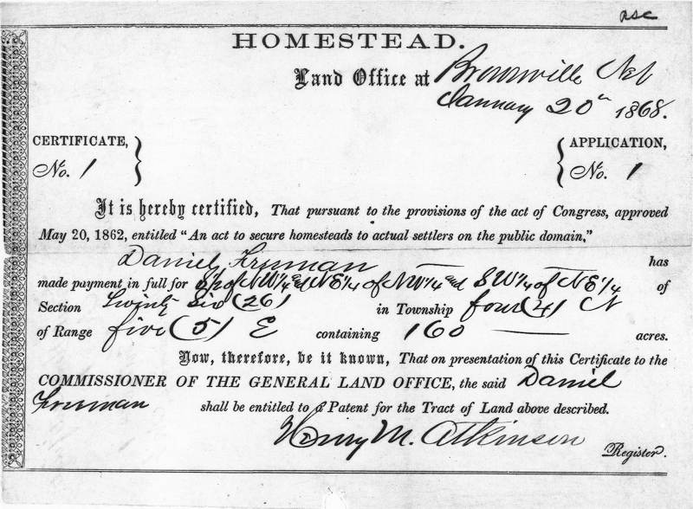
Incorporating the West
Land Acts:
Homestead Act (1862)
160 acres of land to those willing to move west and improve the property
Morrill Act (1862):
Allowed states to sell land and use $ for colleges and universities
Cornell University
Mining Empires:
Comstock Lode – Nevada, huge silver deposits
Timber industries grew in the NW – altered the environment
Cattlemen on the Plains:
Bison rapidly depleted in the 1870s (less than 200)
Cattle ranchers:
Long Drive – herding cattle hundreds of miles north to RRs to sell
Barbed wire allowed farmers to abandon the Long Drive
Led to altering of the Great Plains’ environment
Blizzard of 1886 – 1887 left many cowboys broke
RRs extended into TX and cities developed along RR tracks

Slide 5
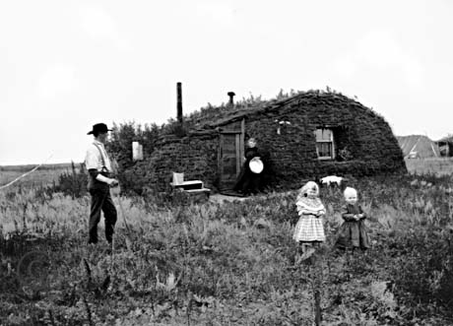
Incorporating the West Cont.
Homesteaders:
Steel plow helped alter the environment of the Great Plains
Farmers could grow crops where they couldn’t before (wheat)
Exodusters:
Movement of African Americans from MI and LA to KS
Women in the West:
Unlike mining and other jobs in the West, homesteading was made up mostly of families
Mormons – settled in Utah to escape religious persecution
Plural marriages (polygamy) led to conflict with the government
Women gained full suffrage in Utah
Environmental Challenges:
Blizzards, tornados, and grasshoppers posed challenges to homesteaders
Often, 160 acres was not enough to survive – arid land
Removing grass to plant led to erosion of soil
The First National Park:
Yellowstone in WY became the world’s fist park
Created in part due to the Northern Pacific RR – owned a hotel
Nez Perce was removed from present day ID, WA, and OR
Tried to flee to Canada, eventually were caught before reaching the border

Slide 6
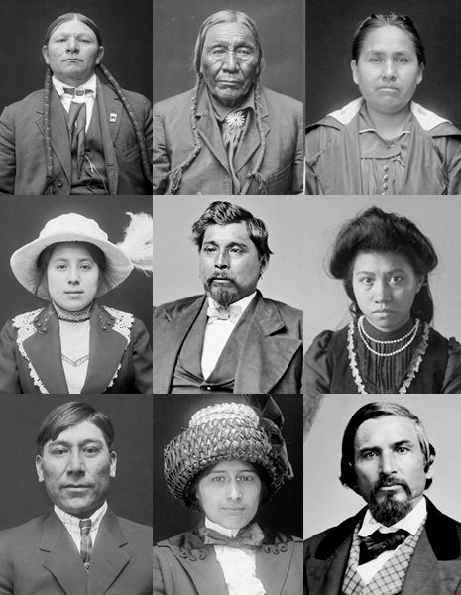
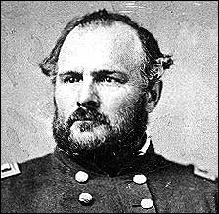
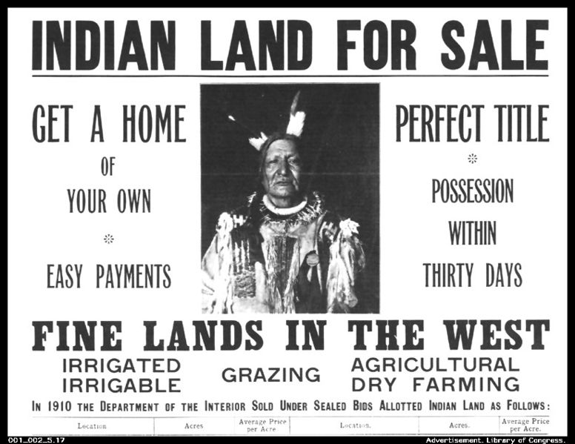
A Harvest of Blood: Native Peoples Dispossessed
The Civil War and Indians on the Plains:
Dakota Sioux were paid to give up land in MN
Most of the funds never went to them
Sand Creek Massacre (November 29, 1864):
CO militia attacked Cheyenne Indians, killed over 100, mostly women and children
Grant’s Peace Policy:
Some reformers believed Natives could be equal with whites
However, the Natives had to embrace Christianity and give up Native cultures
Indian Boarding Schools
Acculturation – adopting white ways
Many Natives were “encouraged” to send children to boarding schools – English only, had to cut their hair
Lone Wolf v. Hitchcock (1903):
Congress could make ANY Native policies it wanted
Breaking Up Tribal Lands:
**Dawes Severalty Act**:
Native tribes were dissolved
Heads of families would receive 160 acres of land
Native Americans’ lives were changed – hunting to farming
Most of Natives’ land was lost (66% between 1880 – 1930)

Slide 7
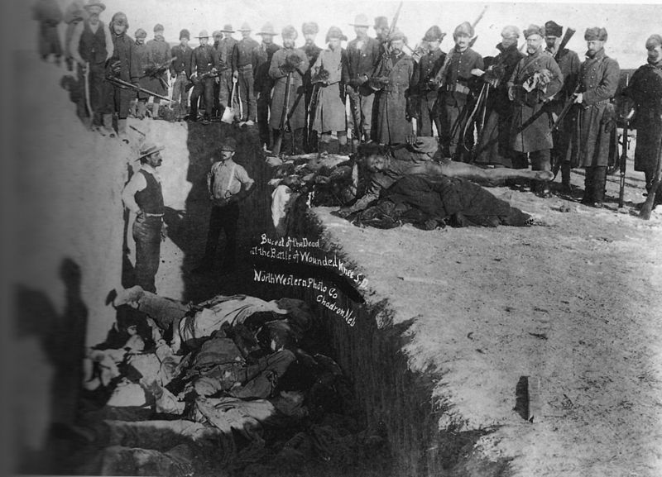
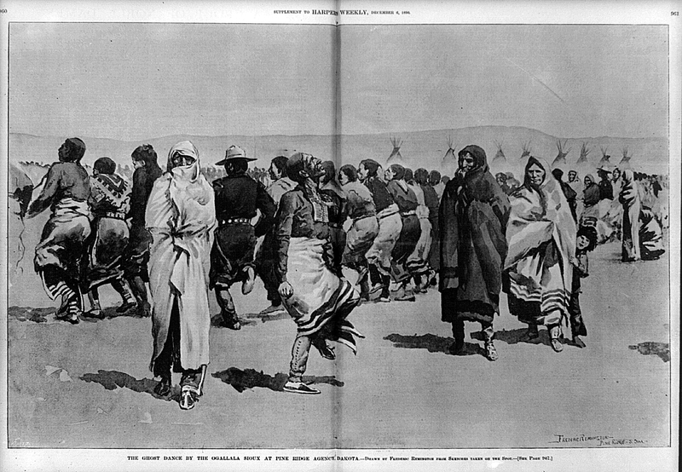
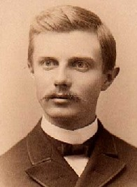
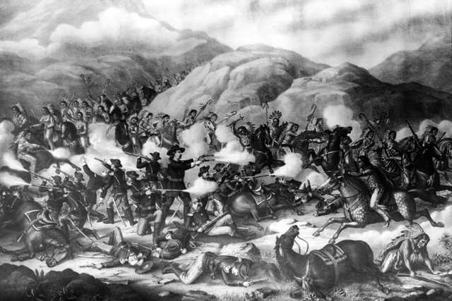
A Harvest of Blood: Native Peoples Dispossessed Cont.
"Up to our own day American history has been in a large degree the history of the colonization of the Great West. The existence of an area of free land, its continuous recession, and the advance of American settlement westward, explain American development."
The End of Armed Resistance:
Sitting Bull and the Lakota Sioux did not go to reservations
Battle of Little Big Horn (Custer’s Last Stand): (1876)
Custer and his men were killed
Strategies of Survival:
Many Natives began to adopt some white customs
Ghost Dance:
Religious movement by Native Americans
Hoped to see the return of buffalo and elimination of whites
Many Americans were afraid of the dance
US government orders an end to it…..
Battle of Wounded Knee (1890)
About 300 Natives were killed
Many were women and children
Western Myths and Realities
Frederick Jackson Turner’s Frontier’s Thesis:
The end of the Frontier ended a unique era in US history
The Frontier contributed to the American identity
Helped make American society different from Europe

Slide 8
Quick Review
US sought to trade beyond its borders post Manifest Destiny:
China and Japan
Government and westward settlement:
RRs and land grants, Homestead Act, Morrill Land Act
Republicans Raise tariffs
Native and US government conflicts:
Sand Creek, Wounded Knee
Dawes Act
Frontier Thesis

Slide 9
Thanks for watching!
Good luck on your tests
Check out videos matching the new curriculum
Spread the word
Subscribe
“Make sure to subscribe. It helps contribute to a unique American identity.”

