Slide 1
Social Changes and Conflicts of the 1920s
6.2: Explain the causes and effects of the social change and conflict between traditional and modern culture that took place in the 1920s, including the role of women, the “Red Scare,” the resurgence of the Ku Klux Klan, immigration quotas, Prohibition, and the Scopes trial.

Slide 2
Causes of Social Change
Misconception: 1920s=carefree boom time
Reality: America divided by change and many did not find prosperity
Social Change: caused by industrialization, urbanization, and immigration
1920: more than half of population lived in cities
More emphasis on science
Social Change led to conflict between traditional American conservatism and modern scientific liberalism

Slide 3
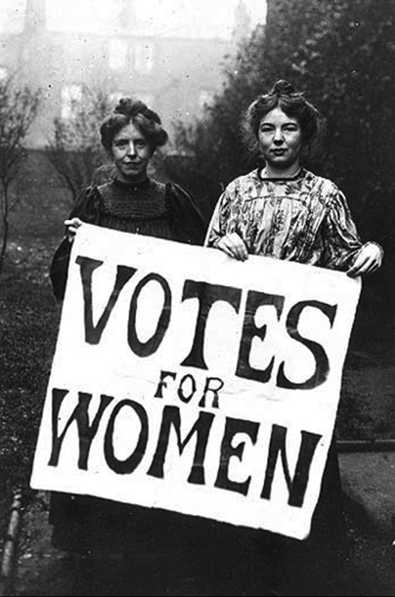
Role of Women
During the war, women took on new jobs to fill in for soldiers
Many gave them up when soldiers returned
Women’s suffrage was passed shortly after WWI
Women did not make politics more moral as they promised, instead using voting as their husbands did
Women did not gain more opportunities in the workplace
Most women continued to work in ‘traditional” female jobs

Slide 4
Traditional Female Jobs
Respectable
Less Respectable
Teachers
Nurses
Telephone operators
Secretaries
Store clerks
Domestic servants
Factory workers
Sweatshop laborers
Prostitutes
Women made significantly less than males

Slide 5
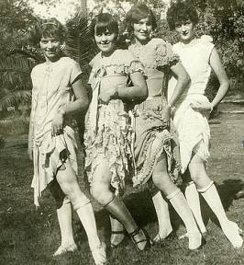
Decline of Morality
Movement to cities nurtured new sexual attitudes and aroused public anxiety about the decline of moral values
Iconic image of the “Flapper” represented this change
Flappers adopted new fashions, attitudes, and habits
New image of women posed little threat to the traditional roles of wife and mother

Slide 6
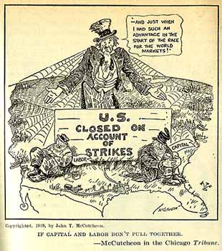
Labor Unrest
High inflation, competition from returning veterans, and end of wartime concessions led to labor strikes
Strikes and the rise of Communism and Socialism (Russian Revolution) frightened middle and upper class Americans
Anarchists exploded bombs in 8 major cities

Slide 7
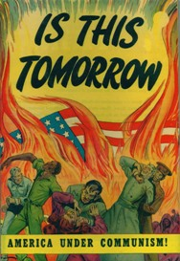
“Red Scare”
Fears of strikes, communism and bombs led to the “Red Scare”
Palmer Raids: government arrested over 4000 alleged communists
Hundreds were deported
Attorney General predicted several more attacks that never occurred
Aroused even more fear against dangerous foreigners

Slide 8
“100% Americanism”
Propaganda increased nativism (hostility towards immigrants) and turned it into xenophobia (fear of foreigners)
Congress passed legislation that authorized quotas to limit immigration
Argument based on Social Darwinism and Anglo-Saxon superiority
Immigration from Southern and Eastern Europe was drastically limited and the ban on Asian immigration was continued (Chinese Exclusion Act)

Slide 9
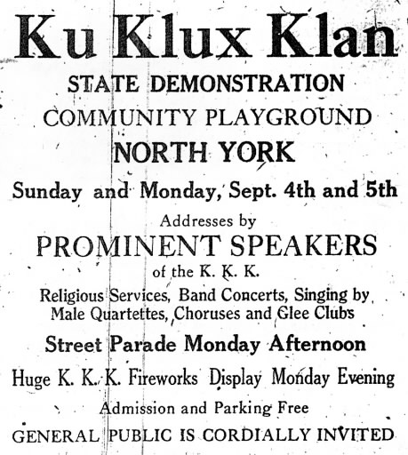
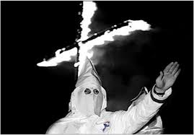
Ku Klux Klan Resurgence
Anti-immigrant sentiment led to the rise of the KKK
1915 film, Birth of a Nation, intensified racism towards African Americans and glorified the KKK as a heroic organization
Increased the popularity of the group
Red Scare added radicals, immigrants and Catholics to the list of targets of the KKK
Used advertisements to promote membership and became a national organization with a strong following in the Midwest and South
Viewed themselves as “moral regulators”
Also targeted bootleggers, gamblers
Used tactics such as cross burnings, public beatings, and lynchings
Sex scandals and corruption undermined the Klan’s claims and the organization began to fade

Slide 10
KKK Comparisons
Klan of Reconstruction
Klan of 1920s
Major Aim:
Major Targets:
Major Tactics:
Geography:
Major Aim:
Major Targets:
Major Tactics:
Geography:

Slide 11
Prohibition
Temperance Movement advocated prohibition to preserve American culture in the face of immigration
18th Amendment prohibited the production, distribution, and sale of alcohol (not the consumption)
Compliance was often a matter of class, ethnic background, and religious affiliation
Illegal sources (mafia) were filling the demand for alcohol and speakeasies were popping up in cities
Government did not have the manpower to enforce prohibition and organized crime grew as a result of bootlegging
Prohibition was repealed in 1933 with the 21st Amendment

Slide 12
Religion vs. Science
Conflict between traditional religious beliefs and science also created anxiety
Religious revivalism led to the development of religious fundamentalism that believed in the literal truth of the Bible
Darwin’s theory of evolution challenged this belief

Slide 13
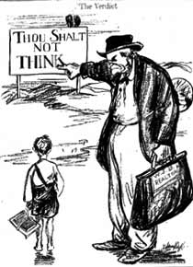
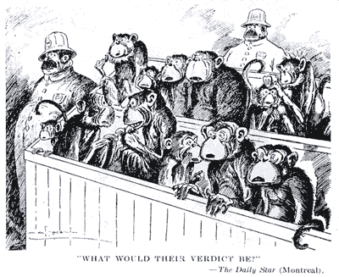
Scopes “Monkey” Trial
Exposed the conflict between religious fundamentalism and modern science
Biology teacher purposefully defied a Tennessee law that forbade the teaching of evolution
Teacher was defended by the American Civil Liberties Union
Case brought the conflict to the national scene but did not resolve the issue
Both sides claimed victory in the argument that remains active today

Slide 14
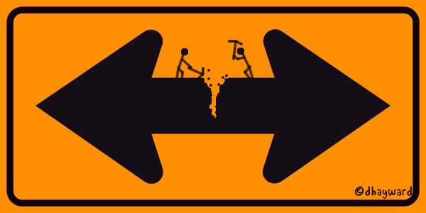
Conservatism vs. Liberalism
Conflict between conservatives who advocate conformity to a traditional moral code and liberals who advocate individual rights changed American society and culture in the 1920s
Conflict still continues today

Slide 15
Conservatives and Liberals Comparisons
Conservatives
Liberals
Beliefs:
Stance on Women:
Stance on Labor:
Stance on Red Scare:
Stance on Immigration:
Stance on Alcohol:
Stance on Religion/Science:
Beliefs:
Stance on Women:
Stance on Labor:
Stance on Red Scare:
Stance on Immigration:
Stance on Alcohol:
Stance on Religion/Science:

